Slide 1
Help Me Grow LA Centralized Access Point
11/02/22
Website: helpmegrowla.org
Call Center: (833) 903-3972
Presenters:
Debra Camp, M. ED, PHN, RN, LA County Department of Public Health
Susanna Lam, MPH, MCHES, LA County Department of Public Health
Laura Stein, MPH, LA County Department of Public Health

Slide 2
OBJECTIVES:
By the end of this session, participants will be able to:
Identify and describe the Centralized Access Point components
Know how to access and refer families to the Centralized Access Point
Know when and how to use Help Me Grow LA

Slide 3
The Help Me Grow Model
A national model promoting early identification and intervention
A collaboration between First 5 LA and the Los Angeles County Department of Public Health
Focus on ages 0-5, but will help all families
Serve all of LA County
No income eligibility

Slide 4
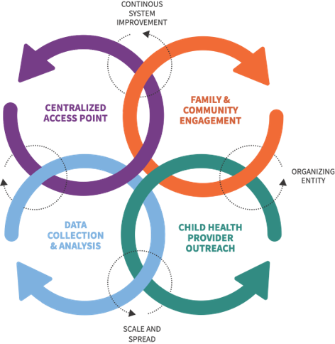
The Help Me Grow Model
Centralized Access Point to help families and providers access needed resources and services.
Engage with Families and Communities to support their child’s development.
Support Child Health Providers to identify developmental concerns and connect families to resources.
Collect and Analyze Data to measure success and improve the coordination of programs and services in local communities.

Slide 5
Centralized Access Point

Slide 6
What is the CAP?
Centralized Access Point: CAP
Call Center: Resource Liaison Team
Website: HelpMeGrowLA.org
Beatriz Perera-Dzul
Mavil Gamez
Debra Camp
Susanna Lam

Slide 7
Levels of Need
Self-Serve: Family or Provider finds what they need on HelpMeGrowLA.org
Resource Assistance: Family or Provider has a simple question about Help Me Grow LA
Resource Navigation: Family needs more in-depth help finding resources and navigating the system of care

Slide 8
Call Center
Call Center: (833) 903-3972
Hours:
Monday – Friday: 8:30 AM - 3:00 PM
Extended hours soon
Staffed by Resource Liaisons

Slide 9
Resource Liaison Team
Navigate: Help families navigate the system of care. Help providers understand the system of care
Connect to resources: Help find resources and agencies
Coach: Help family become confident and competent, ready to talk to an agency, ready to navigate the system of care, ready to advocate for their child

Slide 10
Calling the Call Center

Slide 11
Resource Liaison Navigation Call
Resource Liaison call with parent/caregiver:
Collects information
Makes connections (referrals)
Gives resources
Ensures parent/caregiver knows their next steps
Emails (or mails) call summary to parent/caregiver

Slide 12
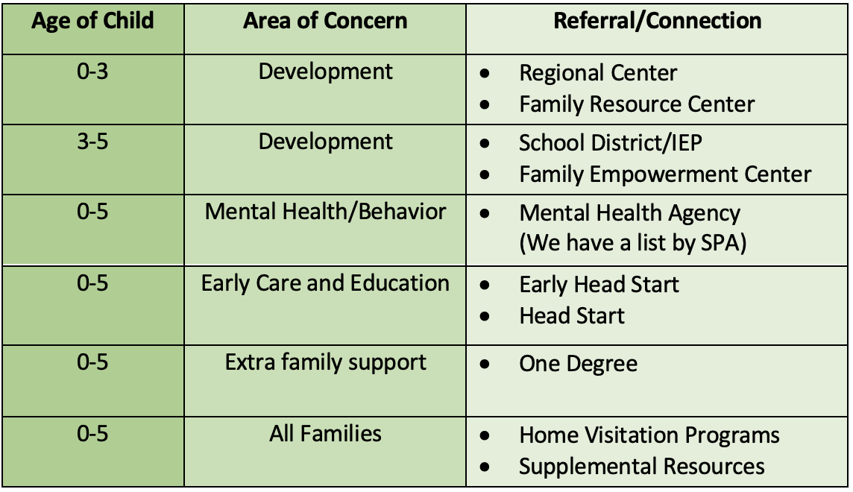
Navigation: Referral Based on Age

Slide 13
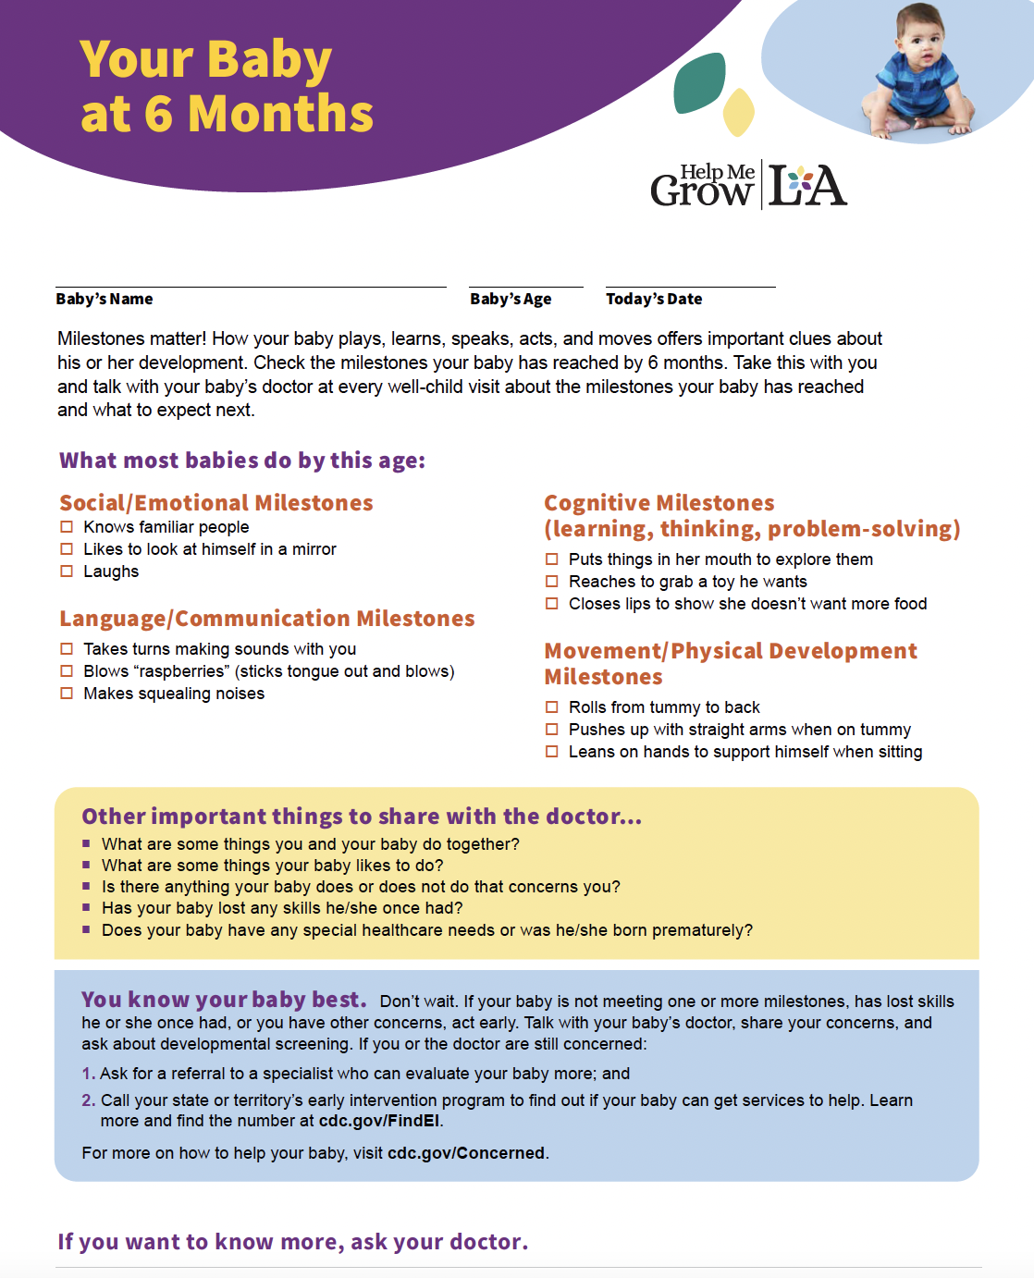
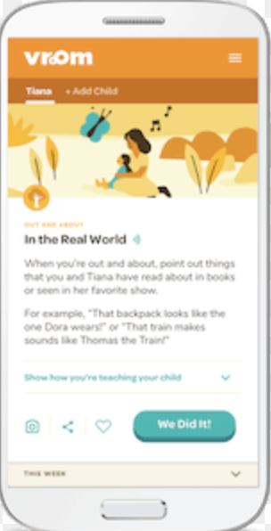
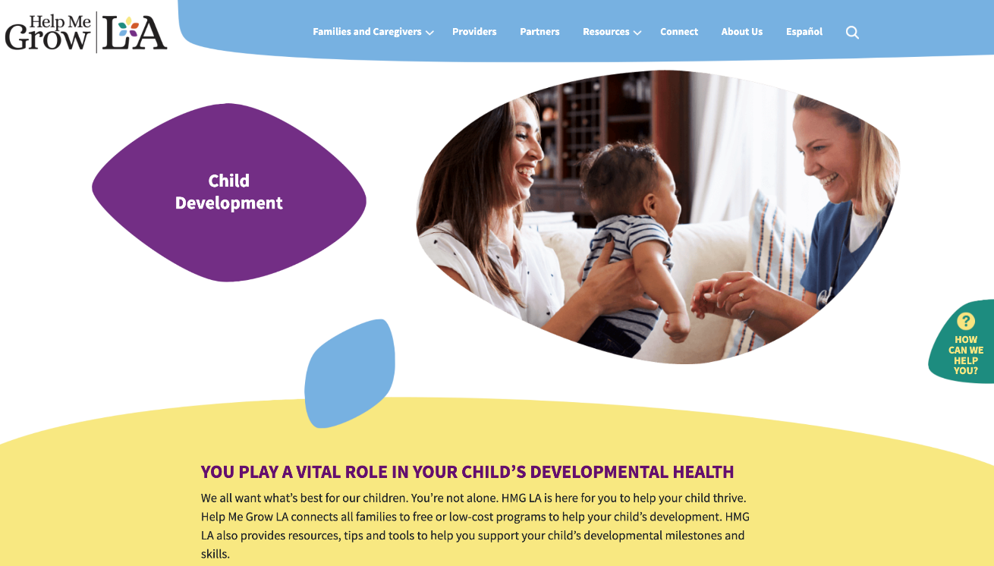
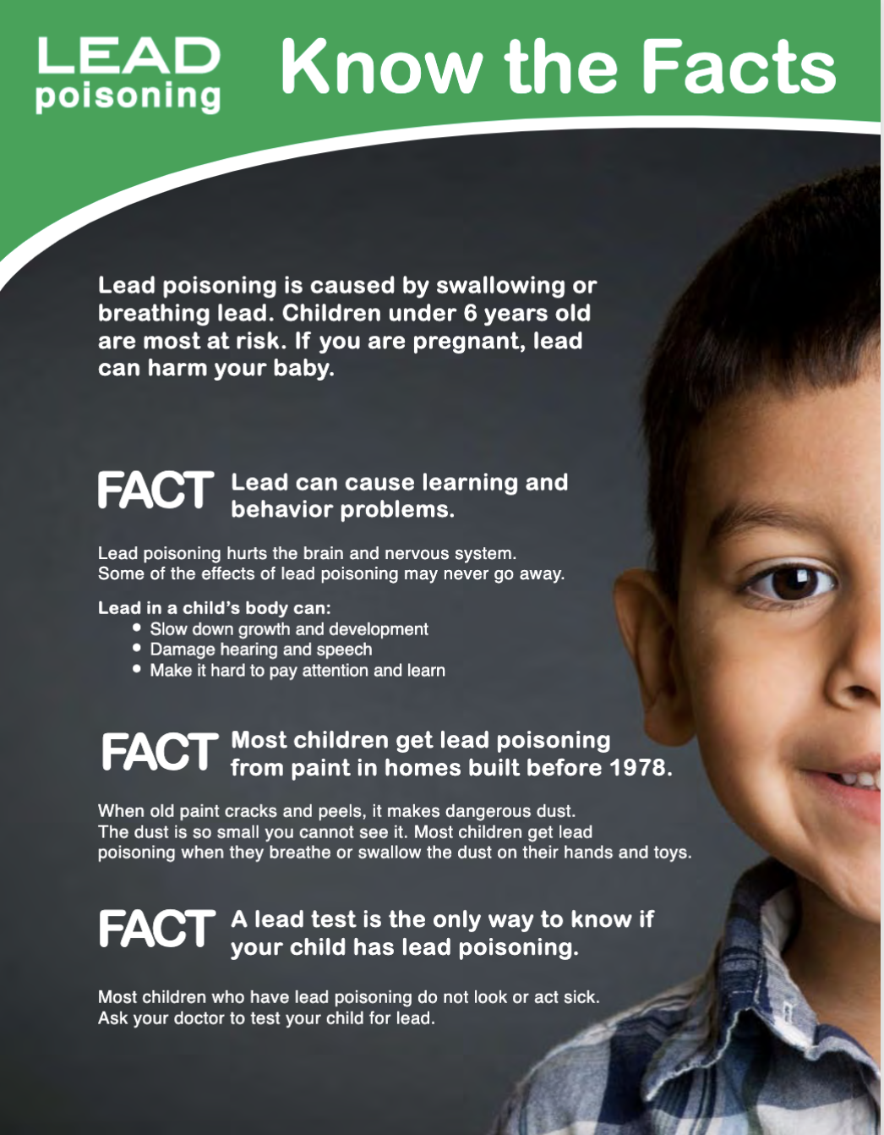
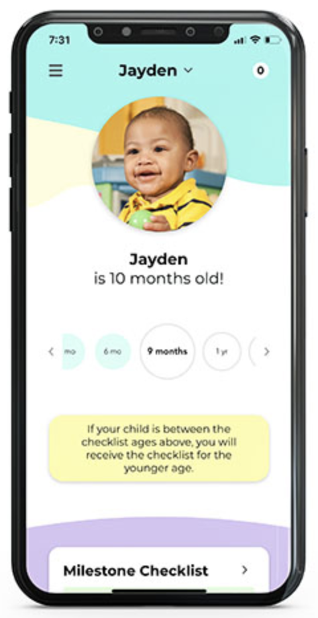
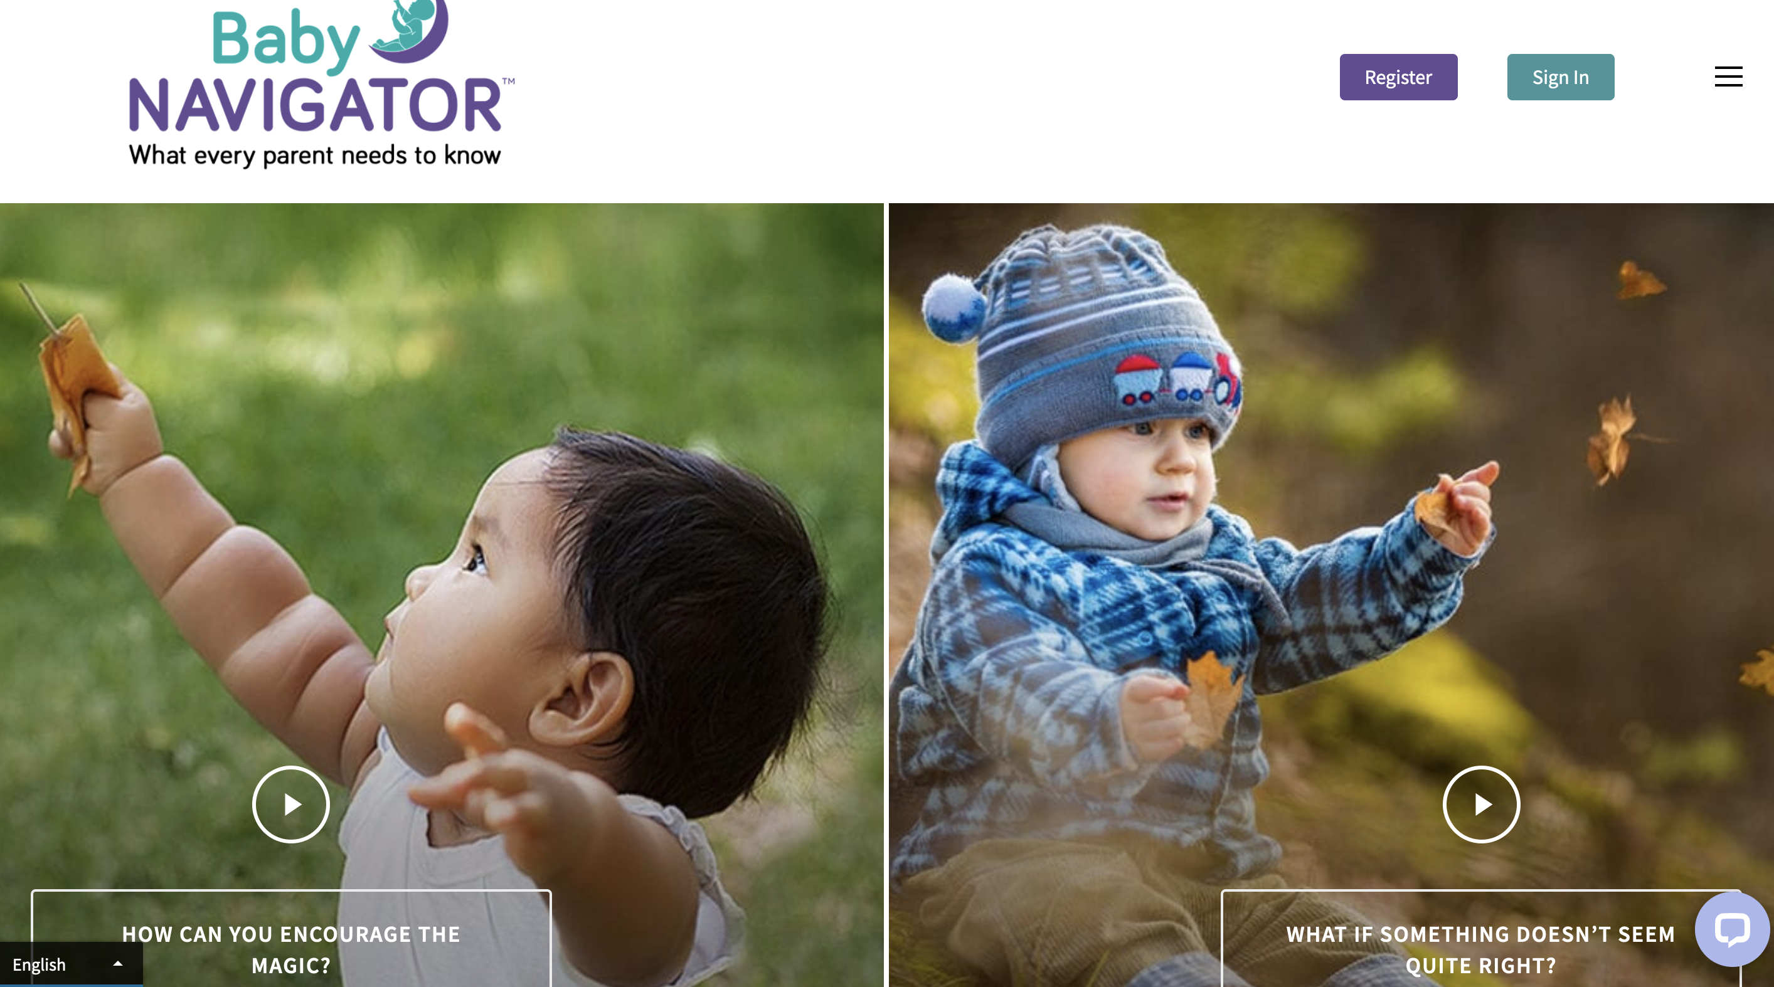
Resources

Slide 14
Follow up
Follow up in 3 weeks:
Successful connections?
Barriers got in the way?
Advocacy resources

Slide 15
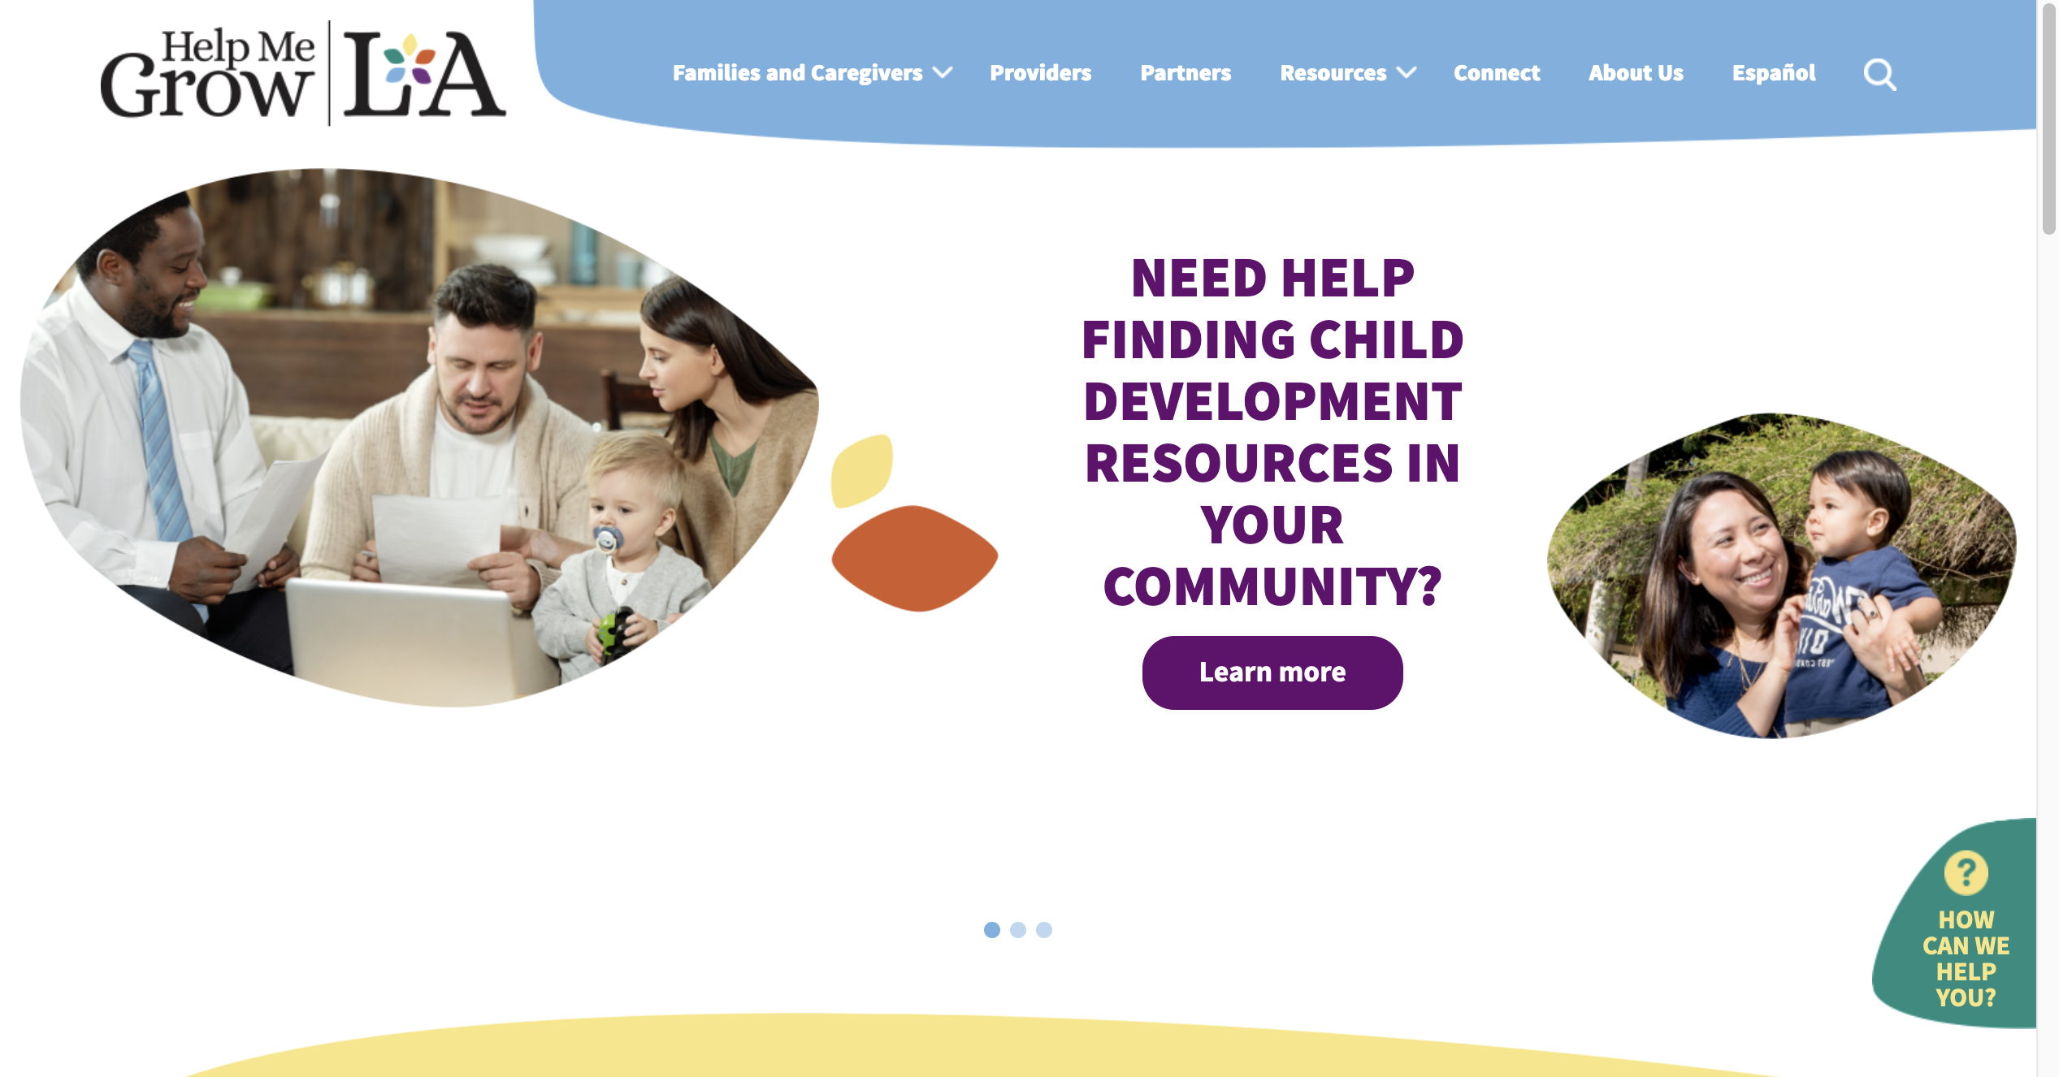
Website
HelpMeGrowLA.org
Self-serve level of need
Resources for Families/Caregivers
Resources for Health Care Providers
Resources for ECE Providers
Other providers
Help Form
Let’s take
a tour!

Slide 16
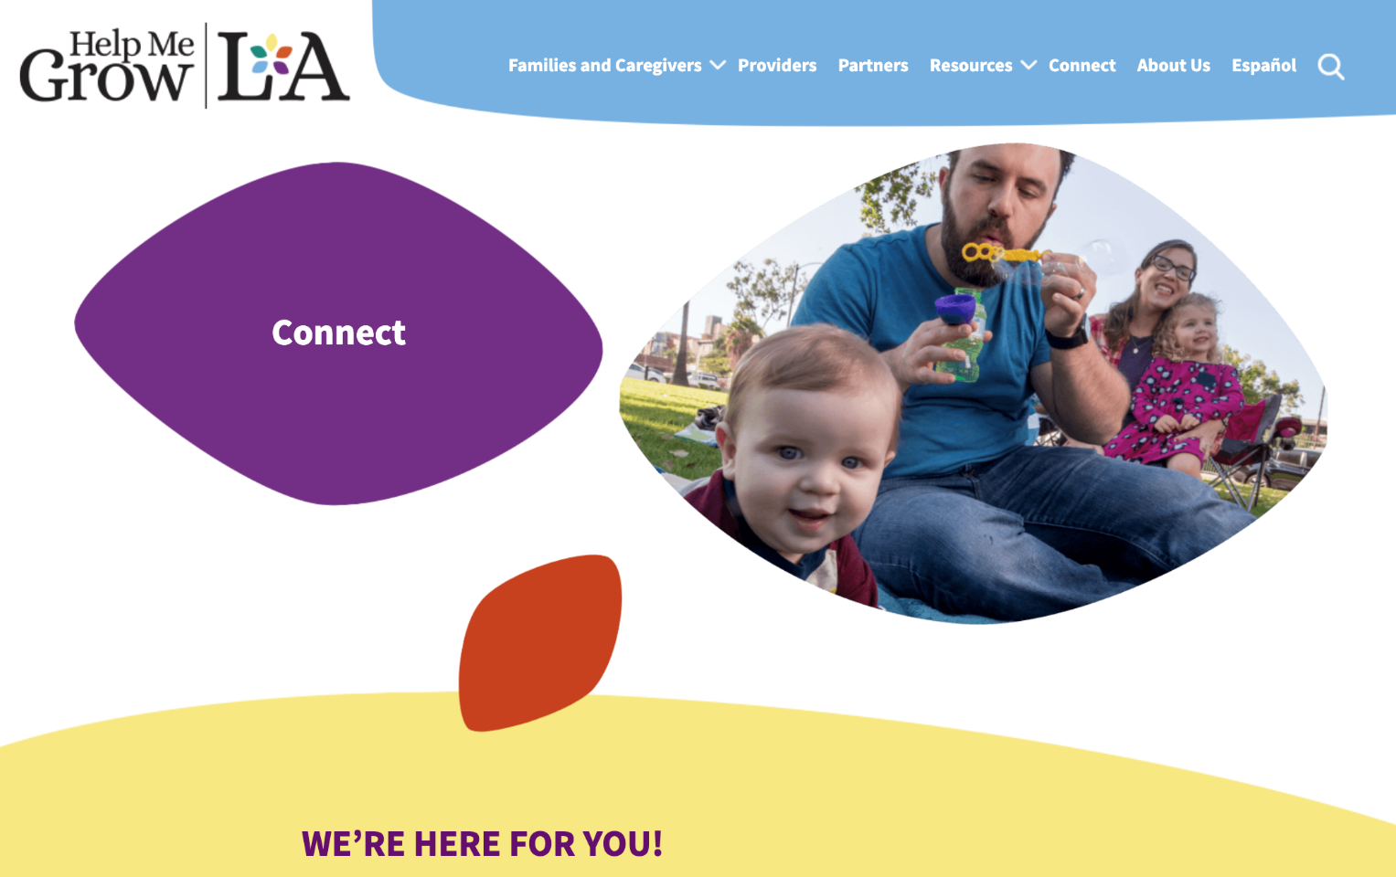
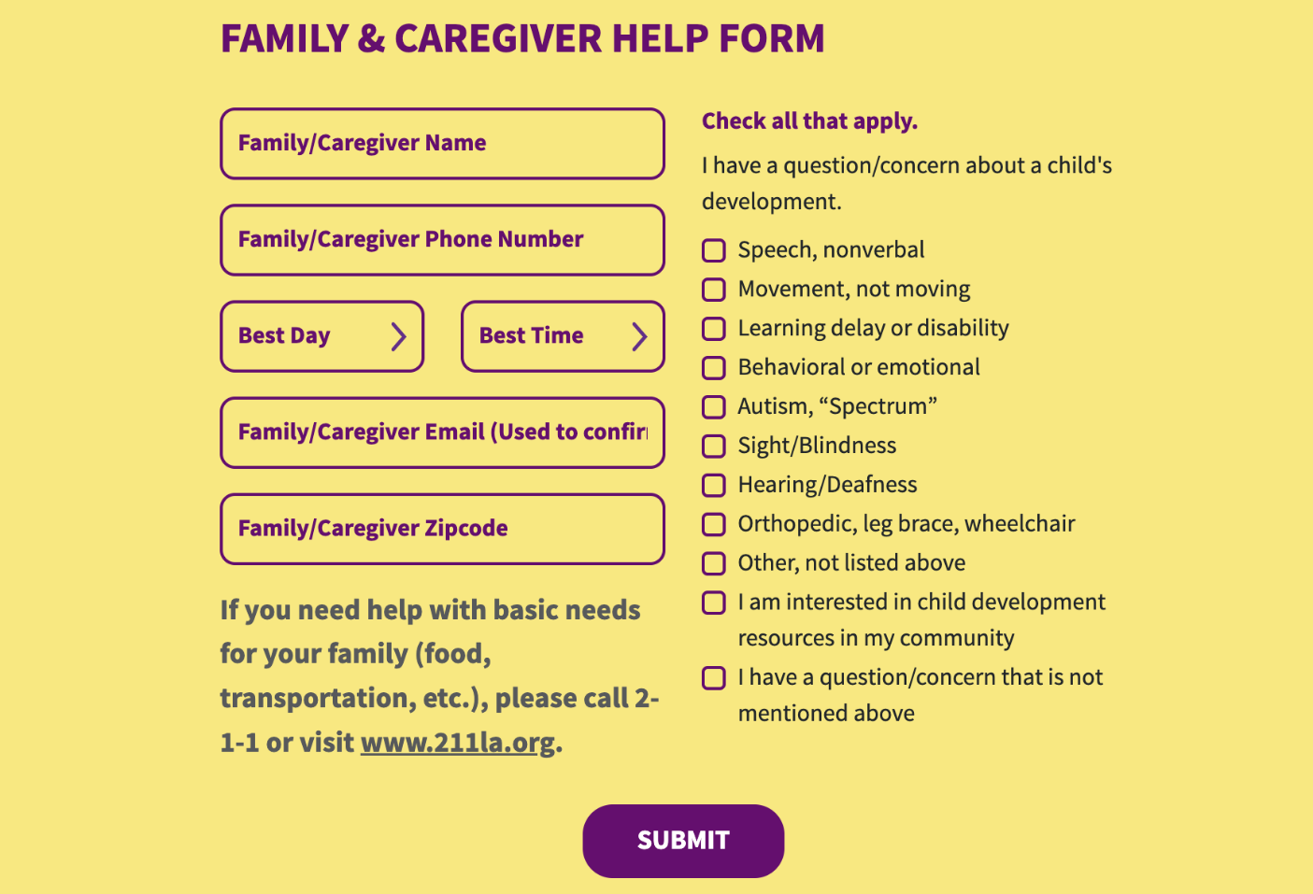
Making a referral to Help Me Grow LA
Call us at (833) 903-3972
Use the Online Help Form
HelpMeGrowLA.org
Connect page
Family & Caregiver Help Form
Click ”submit”

Slide 17
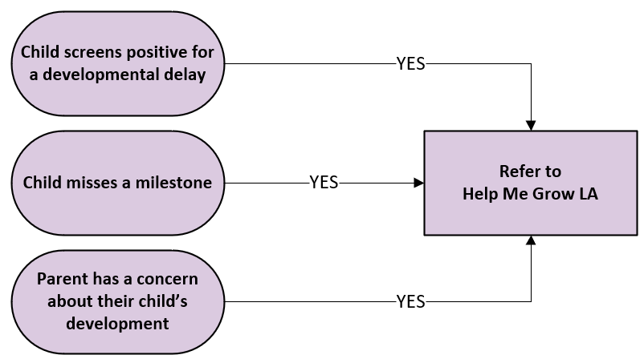
Your Workflow

Slide 18
Stay Connected

Slide 19
Join the Help Me Grow LA Email List
Subscribe to the DPH – Help Me Grow LA email list from LA County: Help Me Grow LA email list from LA County

Slide 20
Schedule a Training
Learn about
Resource Liaisons
Resource Navigation approach
Linkages and resources

Slide 21
Any Questions?
Notes:
Add contact information

Slide 22
Thank you
Website: HelpMeGrowLA.org
Call Center: (833) 903-3972
Contact:
Laura Stein (Program Specialist): LStein@ph.lacounty.gov
Debra Camp (Public Health Nurse): Dcamp@ph.lacounty.gov
Susanna Lam (Staff Analyst): SLam@ph.lacounty.gov
Join the Help Me Grow LA Email List: https://public.govdelivery.com/accounts/CALACOUNTY/subscriber/new?topic_id=CALACOUNTY_1852

