Slide 1
Ilyssa Foxx
QSLA Director –
Child Care Alliance of LA
Katie Kurutz
First 5 LA
Communications Specialist
Gina Rodríguez
First 5 LA
Program Officer
Dual Language
Learner Initiative
RESOURCES
Notes:
Hi Everyone, happy to be here today sharing about the DLL Initiative in LA County. I’m joined by my colleagues: you want to quickly introduce yourselves please.
Great so we’ll be sharing in more detail about the resources we developed through the F5CA funding we received for the DLL expansion study in 2021.

Slide 2
Dual Language Learner Initiative
Lead by Quality Start Los Angeles partners, including LACOE, First 5 LA, and the Child Care Alliance of Los Angeles
Includes trainings and resources for early educators and families, in several languages
Communications Campaign - Early Edge and Unite-LA
Notes:
GINA
Lead by Quality Start Los Angeles partners, including LACOE, First 5 LA, and the Child Care Alliance of Los Angeles Includes trainings and resources for early educators and families, in several languages
Communications Campaign - Early Edge and Unite-LA
After the grant cycle ended, F5LA provided a small amount of funding to complete the communications campaign so we added additional partners (Early Edge and Unite-LA) to amplify the DLL and Multilingualism messaging across LA County. And we created a communications workgroup to share resources and align messaging and not work in isolation. What you’ll see later on in the presentation is that F5LA was able to identify additional IMPACT funding and this is what accounts for the communications campaign you’ll hear about today.
—Ilyssa
Alignment of content and resources and messaging across provider and family and comms, dispel myths, we know that over 60% of children in CA are dlls, multi-lingual learners and rising

Slide 3
Family Workshops and Handouts: (English, Spanish, Mandarin, Cantonese)
Your Home Language is Important
Maintaining Your Home Language
Advocating For Your Young DLL
Self-paced
Male/Father Engagement Workshop and Handout (English and Spanish)
Focus on Fathers: Raising Dual Language Learners
Family Cafes (English, Spanish, Mandarin, Cantonese)
Notes:
Ilyssa
365 participants (duplicated) attended one of the 8 Family Workshops, 795 enrolled
Cantonese: 69, English 72, Mandarin 146, Spanish 78
Family Cafes: 97 attendees across 8 cafes
Male Engagement: 17 attendees across 3

Slide 4
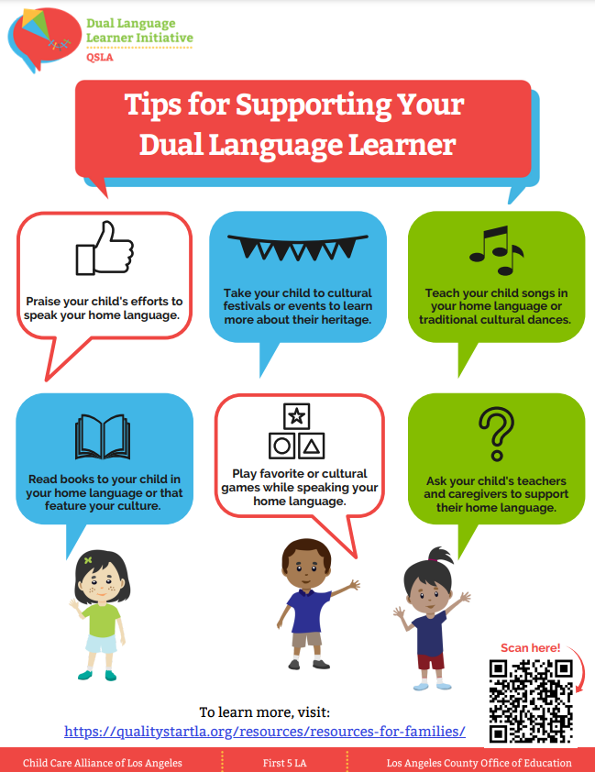
Additional Resources for Families
DLL Family Resources: English, Spanish, Chinese
Handouts, links to websites, videos
Read Together, Create Together (many languages)
DLL: Parent Perspective Videos (YouTube) (Eng/Spa/Chi)
Multilingual Books!
Notes:
Ilyssa Read Together, Create Together: https://youtube.com/playlist?list=PLZHH3XOgT56ftrXtpFmrvWA7rhr9zsfeu&si=AB5FY6YpIkEZkLjK
Parent Perspectives: https://www.youtube.com/playlist?list=PLZHH3XOgT56fQJfng8bEzeh8VmaNPfR7j (English)
https://www.youtube.com/playlist?list=PLZHH3XOgT56eiRH1Hvnv5VGJokXyame94 (Spanish)
https://www.youtube.com/playlist?list=PLZHH3XOgT56fyqCwsdO_sb4CaShqPM2TG (Chinese)
Over 5000 books distributed

Slide 5
DLL Resources: Early Educators (English, Spanish, and Chinese)
Articles, videos, handouts, etc.
DLL Professional Development:
R and Rs offering Provider DLL Trainings
Self-paced workshops (3 languages, 10 workshops-under development)🚧,
2 completed in English/Spanish/Mandarin
Notes:
Ilyssa

Slide 6
Campaign Development
Target Audience: Families whose home language is Spanish or Chinese
Strategies/Tactics (3 is the magic number):
Trusted Sources - Equip trusted sources with a display poster and multilingual brochures to support a conversation with families about multilingualism.
Paid Media – Reach families where they live and work with key messages and links to resources.
Social Media – Reach families on social media with key messages and links to resources.
Notes:
Katie

Slide 7
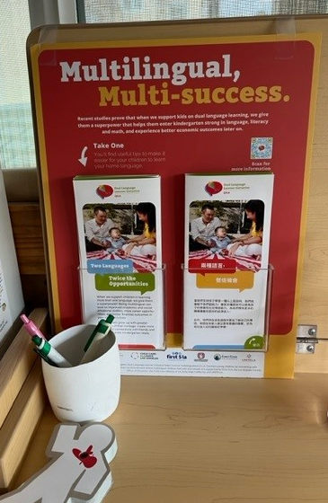
Trusted Sources: Distribution
Working with QSLA, LACOE and LA Babies Best Network, we distributed 280 posters, 30,000 Spa/Eng and 10,000 Chi/Eng brochures, along with multilingual instructional letters to the following trusted sources:
129 Child Care Businesses (63 Eng, 28 Spa, 38 Chi)
15 L.A. City Libraries
83 L.A. County Libraries
34 Welcome Baby/Select Home Visitation Sites
Zhang FCC
Notes:
Katie

Slide 8
Paid Media: Targeted Outdoor
Locations for outdoor placement were chosen based on zip code of child care centers and areas with the largest Spanish and Chinese speaking populations.
Outdoor included:
235 Convenient Store Posters
100 Bus Benches
3 Digital Billboards
Until the end of August
All QR Codes drive traffic to the in-language and parent-focused sections of the QSLA website.
Notes:
Gina

Slide 9
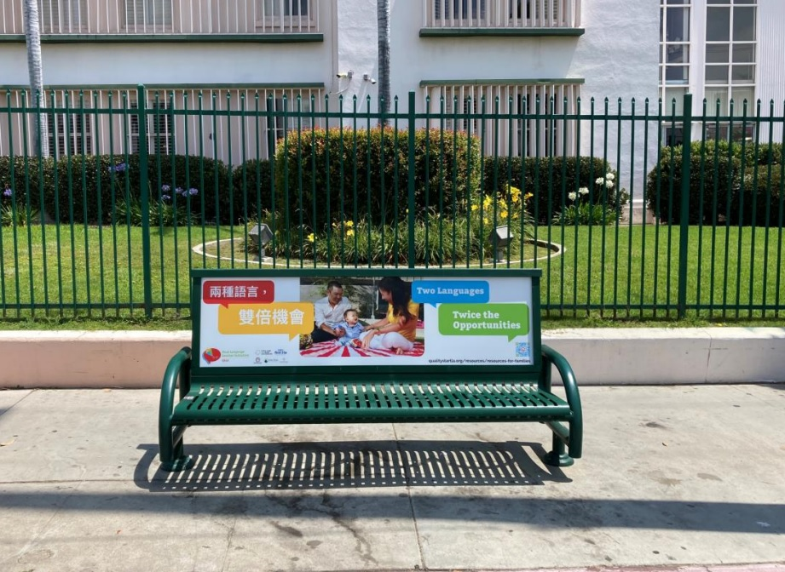
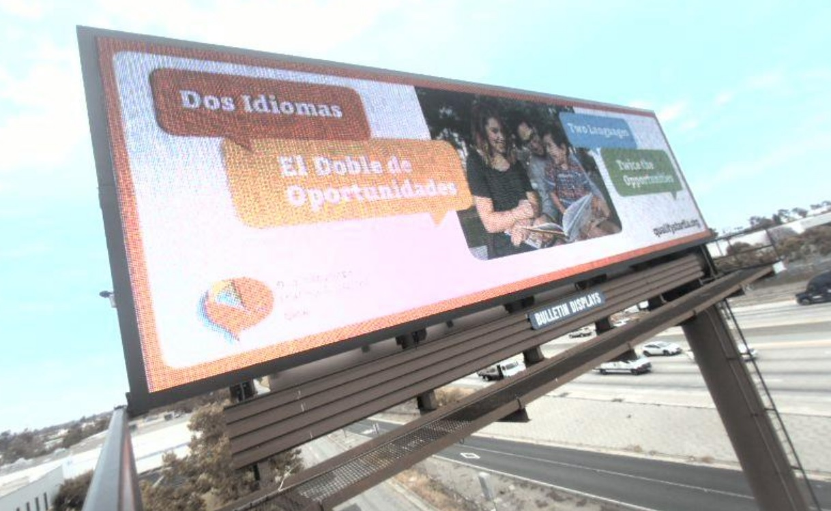
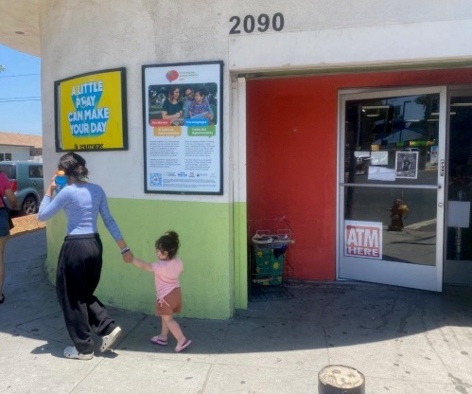
Paid Media: Targeted Outdoor
Notes:
Gina

Slide 10
Paid Media: Digital Banner Ads
L.A. Times/L.A. Times Español
La Opinion
iCityNews
Power 106
Cali Radio (Reggaeton)
Univision
Run time through August
Notes:
Katie

Slide 11
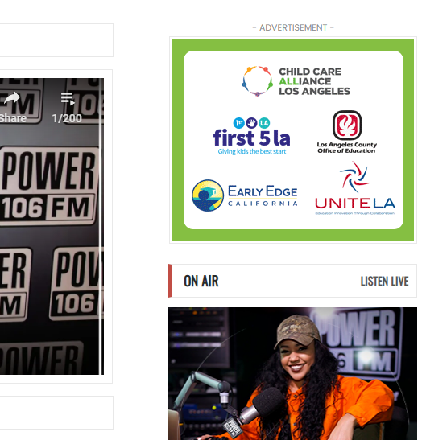
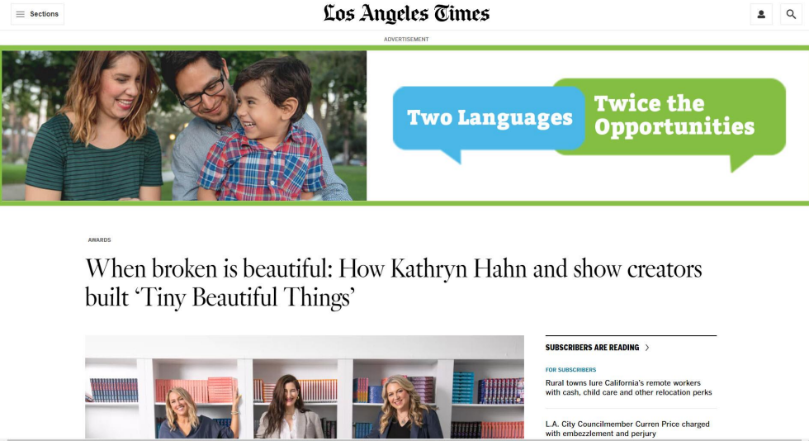
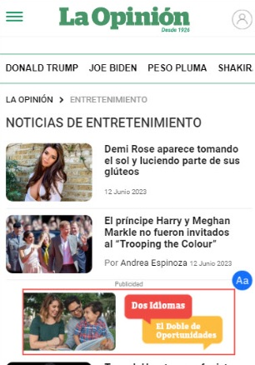
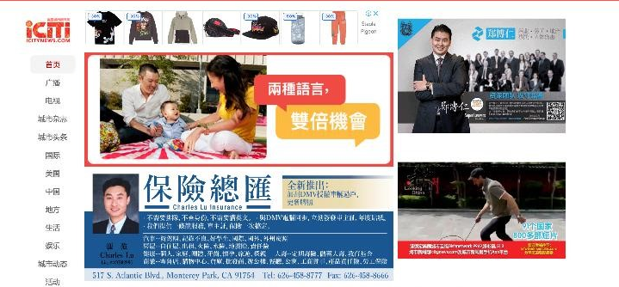
Paid Media: Digital Banner Ads
Notes:
Katie

Slide 12
Paid Media: Radio Spots
Univision (Spanish)
KWMR (Chinese)
Power 106 (English)
iHeartRadio (English)
Click here to listen
Notes:
Katie
Stats?

Slide 14
Additional Components
Paid Media: Article in MomsLA.com:
Two Languages, Twice the Opportunities: Why Speaking More Than Language Gives Children a Superpower
Pitch and Place: L.A. Times Reading by 9: Article to be published August/Sept
First 5 LA website:
Campaign Launch Encourages Dual Language Learning Across L.A. County
Notes:
Katie

Slide 15
Coming This Year…
DLL Campaign Expansion: Armenian, Khmer,Vietnamese, Korean 🎉
DLL Provider Series-Train the Trainer (English, Spanish)
DLL Family Workshop Series-Train the Trainer (English, Spanish, Mandarin)
DLL 10 Part, Self-paced provider trainings (English, Spanish, Mandarin)

Slide 16
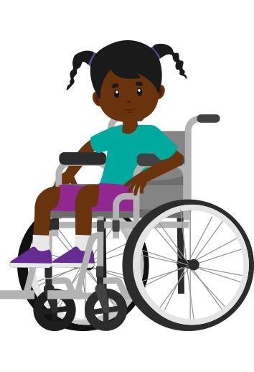
Thank you!

