Slide 1



Child Care Planning Committee
Los Angeles County
Local Child Care and Development Planning Council (LPC)
Manuel Fierro, Chair
Andrea Fernandez Mendoza, Vice Chair
Wednesday, September 3, 2025
12:00 p.m. to 2:30 p.m.

Slide 2


Welcome and Introductions
Vision Statement
Children are healthy, thriving and have equitable opportunities to achieve optimal development and succeed in life.
Mission Statement
Lead, build, and strengthen an affordable and high-quality early care and education system for the children and families of Los Angeles County.
2

Slide 3

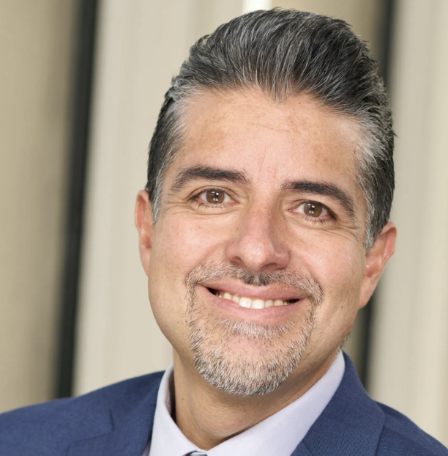
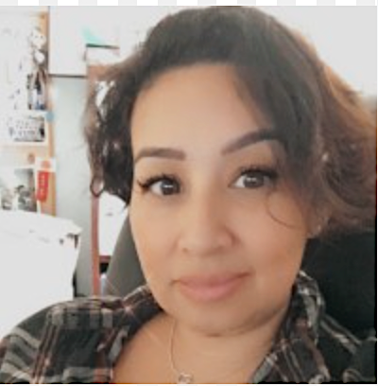
Welcome and Introductions
Chair
Vice Chair
Manuel Fierro
Community Organization
Catalyst California
Andrea Fernandez Mendoza
Early Educator
California Children’s Academy
3

Slide 4
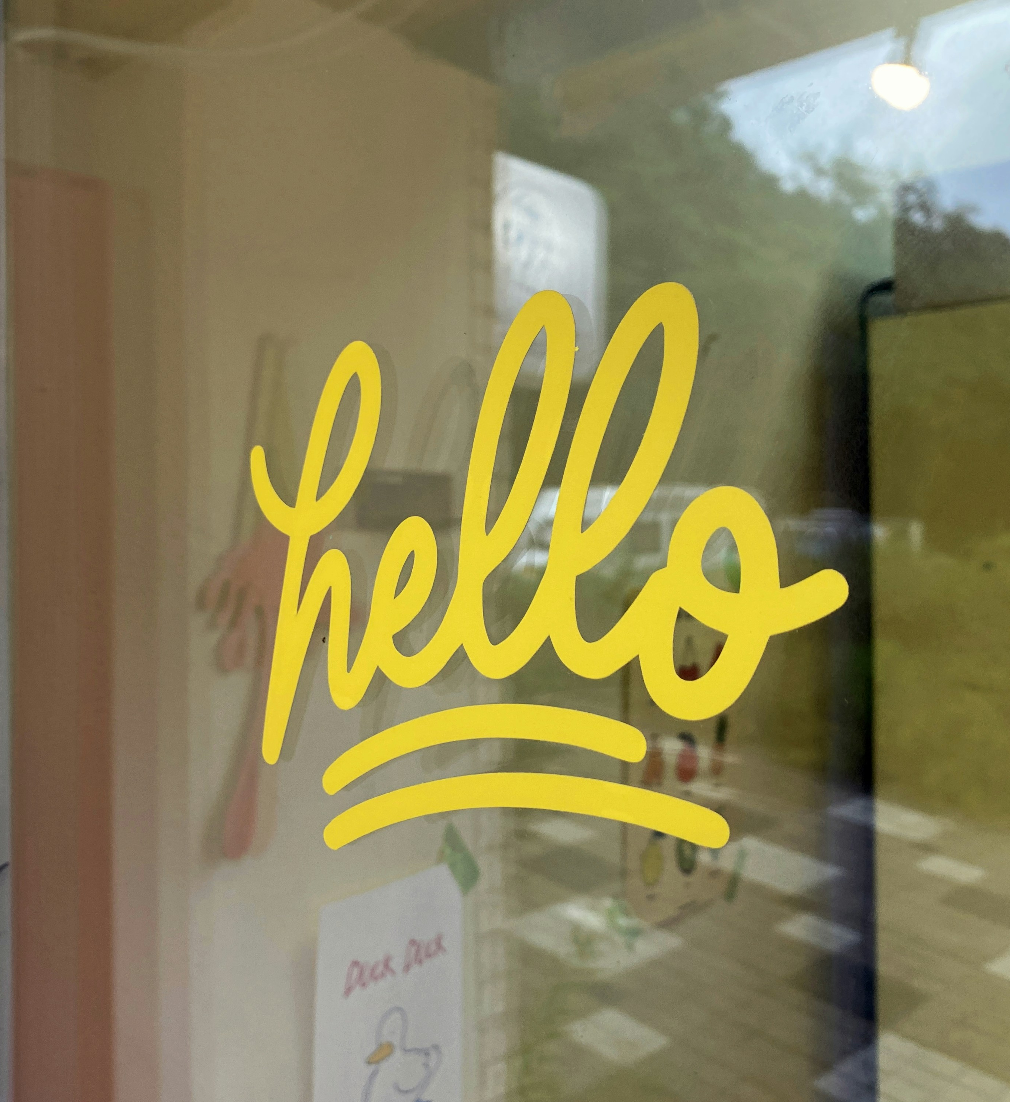

Welcome and Introductions
Please share your:
Name
Role as a Child Care Planning Committee Member, Alternate, or Guest
Organization or Affiliation, if it applies
4

Slide 5

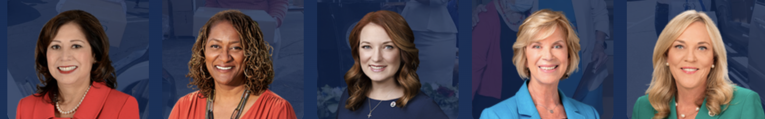



Los Angeles County Early Care and Education Overview
Los Angeles County
Board of Supervisors (BOS)
Los Angeles County
Department of Public Health (DPH)
Los Angeles County Office For The Advancement Of Early Care and Education
(OAECE)
Los Angeles County Child Care Planning Committee/Local Planning Council (LPC)
5

Slide 6
Councilmember Presentation of Appointments
Los Angeles County’s Local Planning Council (LPC)
Child Care Planning Committee Fiscal Year 2025-2026
Community Organization | Discretionary | Early Educator | Parent/Caregiver | Public Agency
Aurora Lopez | Anna M. Lopez | Ancelma Sanchez | Christina Moore | Alicia Rivas
Betty Collins | Dianne Philibosian | Andrea Fernandez Mendoza | Crystal Thompson | Bobby Guerrero
Edilma Serna | Eva Rivera | Brittie Crawford | Eli Pessar | Gus Bribiesca
Fiona Stewart | Ivy Chang | Danielle Craig | Elsa Leal | Jessica Kim
Gina Rodriguez | Jessica Guerra | Erendira Doherty | Humberto Manuel Estratalan | Kelly Fountain
Joelle L. Landazabal | Jill Lee | Justine Lawrence | Jen Baca Beltran | Nellie Ríos-Parra
Manuel Fierro | La Tanga Hardy | LaShon Tillie-Jones | Jessica Reynaga | Rachel Bocarsly
Mirel Herrera | Sarah Soriano | Leidy Milla Bernasconi | Mona Franco | Tracey Washington
Samitha Givens | Vanessa Macias | Saul Hurtado | Nicole Baitx Kennedy | Ufuoma Akwaja
Stacy Lee | Appointee 1st Supervisorial District | Sylvia Hernandez | Sasha Duarte | Vanessa San Martin
6

Slide 7


Strengthening the ECE Community in Times of Change
Manuel Fierro, Chair
Andrea Fernandez Mendoza, Vice Chair
7

Slide 8
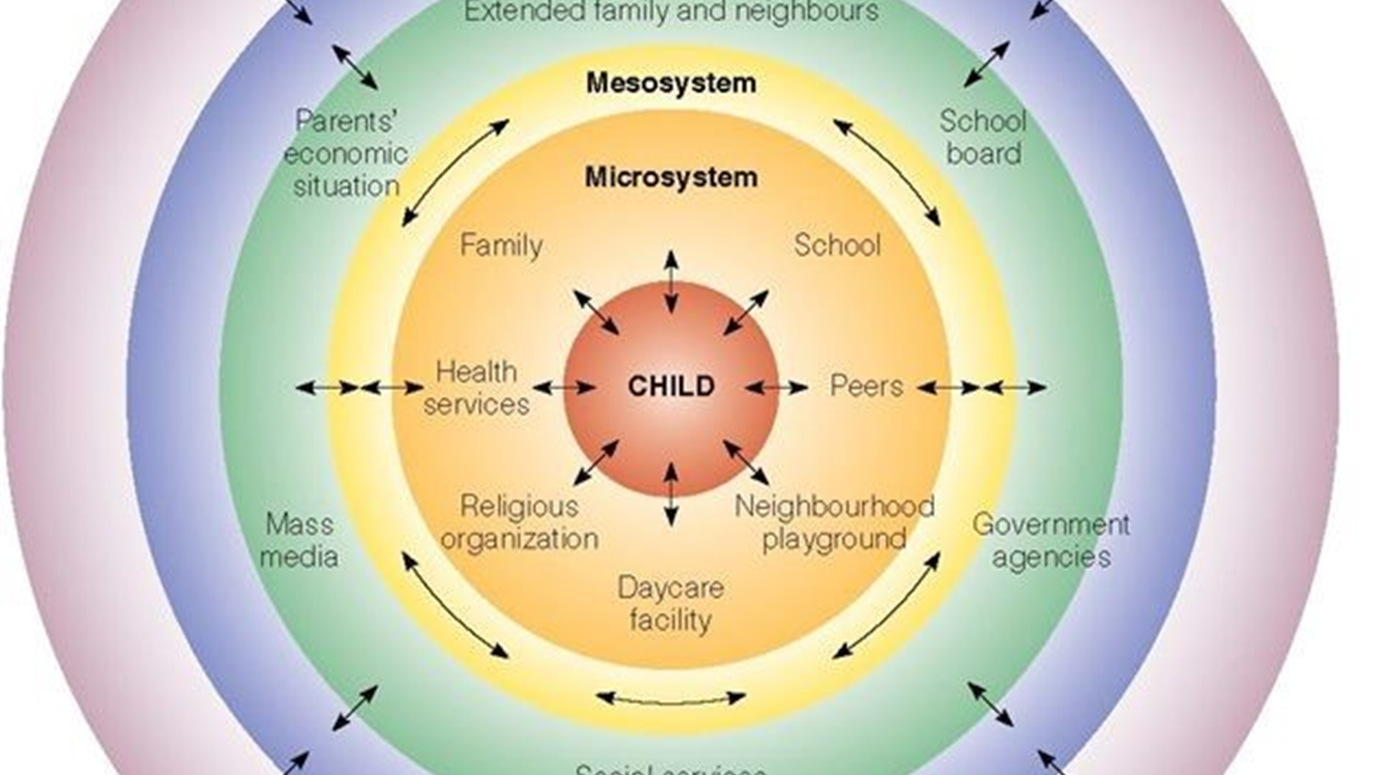
Microsystem and Mesosystem
8

Slide 9






Federal Threats
9

Slide 10
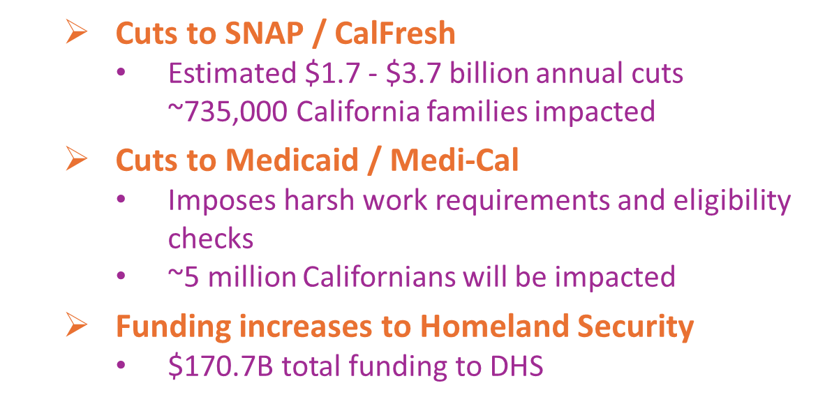





HR 1
The passage of the HR 1 will have negative impacts for whole child, whole family needs.
10

Slide 11
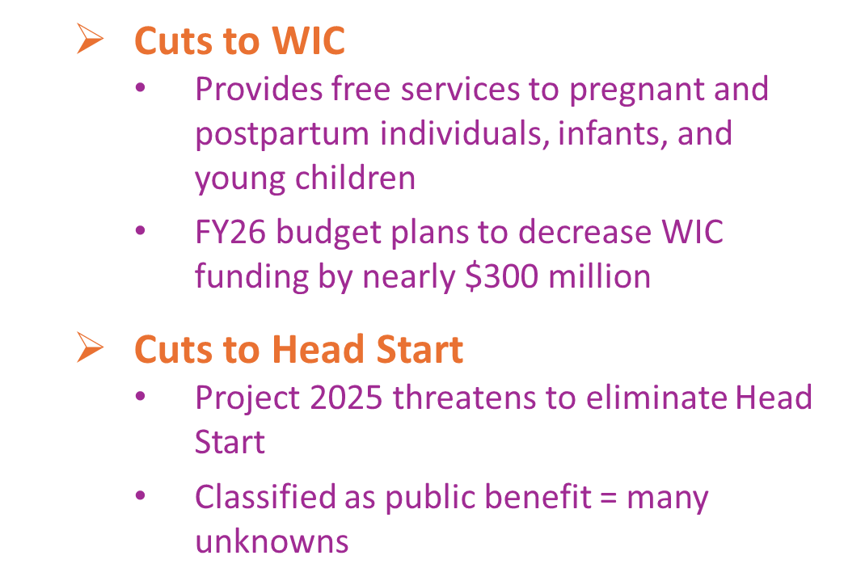

Additional Federal Threats
11

Slide 12
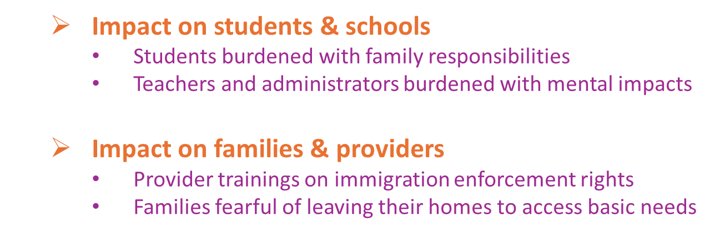
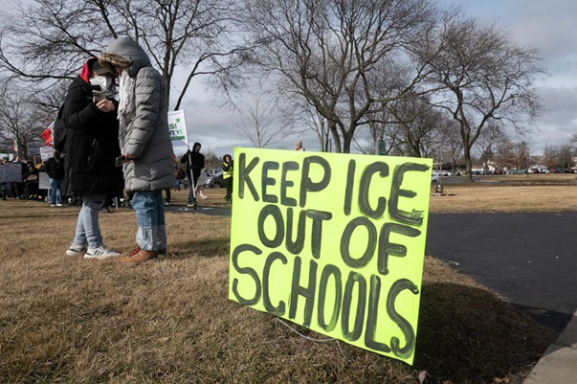
Immigrant Children and Families
12

Slide 13
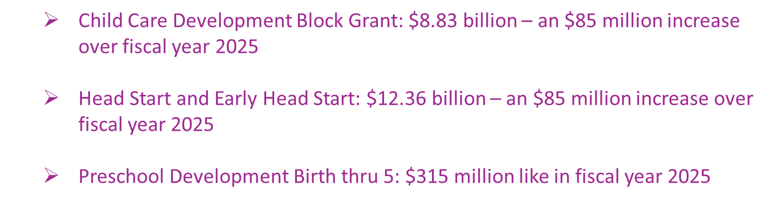

Early Learning Funding Fiscal Year 2026
13

Slide 14






Key Responsibilities of the Planning Committee
Complete the LPC Local Funding Priorities and certify membership annually
Coordinate the Voluntary Temporary Transfer of Funds process
Provides input on policy issues through the Joint Committee on Legislation
Develop a Child Care Needs Assessment every five years
Develop countywide ECE strategic plan every five years
Plan for Universal Prekindergarten Mixed Delivery System
14
Notes:
I would like to spend a few minutes highlighting some of the key responsibilities of the Child Care Planning Committee.
Again, the Child Care Planning Committee is LA County’s Local Planning Council. I will use the terms interchangeably.
Both the funding priorities & voluntary transfer of funds are done annually, and every five years we produced the ECE Needs Assessment and a new strategic plan.
The policy priorities and legislative agenda are updated as needed.

Slide 15

Responsibility #1: Voluntary Temporary Transfer of Funds
Temporary transfer of funds between ECE contracts from the California Department of Education or the California Department Social Services
  Available for programs that may be under- or over-earning their contracts.
  Ensures that funds are retained within LA County
Eligible Programs
  General Child Care and Development (CCTR)
    Includes CCTR administered Family Child Care Home Education Networks (FCCHEN)
  Family Child Care Home Education Network (CFCC)
  Alternate Payment Program (CAPP)
  California State Preschool Program (CSPP)
Timeline
  Fall – October/November 2025
  Spring – April/May 2026
15

Slide 16
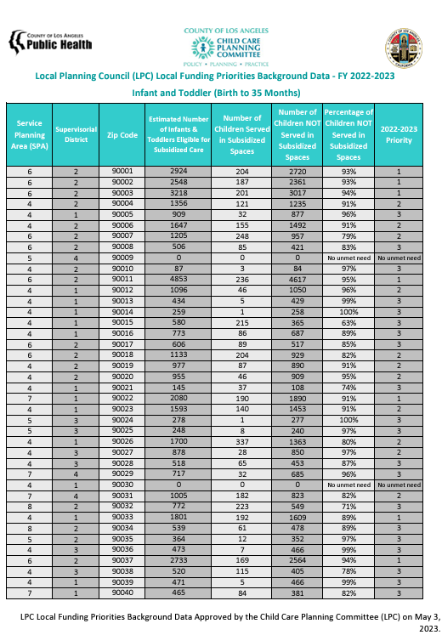
Responsibility #2: Local Funding Priorities
What is it?
Compares the number of LA County children income eligible* for subsidized early care and education services, to the number of children enrolled in subsidized early care and education
  *ELNAT defines “income eligible” in alignment with the state eligibility guidelines according to the year of the data set.
Separated by zip code & age group
How is it used?
State departments consider the report when distributing funding to promote equal access to child development services
Excel and PDF reports are available at childcare.lacounty.gov/lpc/#activities
*Management Bulletin 15-04. Local Child Care and Development Planning Council Funding Priority Setting Process. June 2015. Available at https://cdss.ca.gov/inforesources/child-care-and-development/quality-improvement-initiatives/local-child-care-and-development-planning-councils/management-bulletin-15-04
16

Slide 17

Responsibility #3: ECE Strategic Plan
Early Care and Education(ECE) Strategic Plan
Comprehensive countywide plan
Developed every five years
Current Strategic Plan
- Access
- Quality
- Workforce
- Families and Communities
  New strategic planning is taking place in FY 25-26
17

Slide 18





Responsibility #4: Universal PreKindergarten
Universal PreKindergarten (UPK) Mixed Delivery Planning Grant
Goal 1: Increase parents’ knowledge about their early education choices
Goal 2: Strengthen partnerships between school districts and ECE mixed delivery systems
Goal 3: Enhance partnerships to support children with special needs
Goal 4: Increase supports for UPK workforce
18

Slide 19
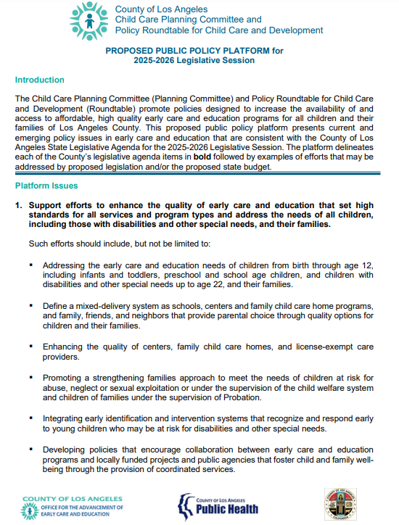
Responsibility #5: Joint Committee on Legislation
Standing Committee
  - Held by Brown Act and meets in-person
Appointees
  - 4 appointees from Child Care Planning Committee
  - 4 appointees from Policy Roundtable for Child Care and Development (Policy Roundtable)
Purpose
  - Discusses the State and Federal budget
  - Analyzes proposed State and Federal legislation
  - Informs positions on ECE issues which are approved by the Policy Roundtable.
19

Slide 20

Roles and Responsibilities FY 25-26
?
?
?
?
Questions:
Comments from Councilmembers
Comments from the Public
20

Slide 21
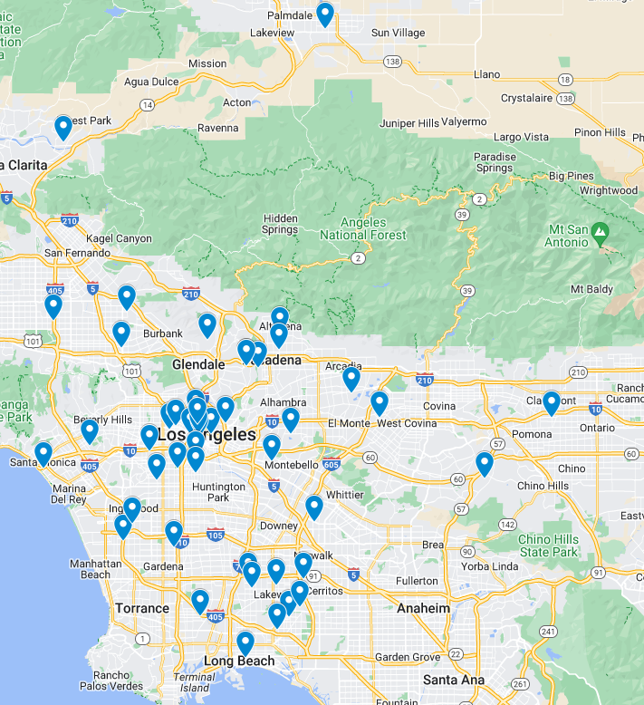
Child Care Planning Committee/LPC Overview
Planning Committee/LPC Member Representation in Los Angeles County
Welfare and Institutions Code
    20% shall be consumers (parents and caregivers)
    20% shall be child care providers
    20% shall be public agency representatives
    20% shall be community representatives
    20% shall be at the discretion of the appointing agencies
Governing Process
    Chair and Vice Chair
    Roberts Rule of Order
    Brown Act
21

Slide 22

Roberts Rules of Order
What it is
  Guide to conducting meetings and making decisions as a group
How it works
  A decision is carried out through a motion, which is a proposal to do something
Who is involved
  A member may propose a motion or vote
  An alternate may act in the role of a member if the member is not present

Slide 23
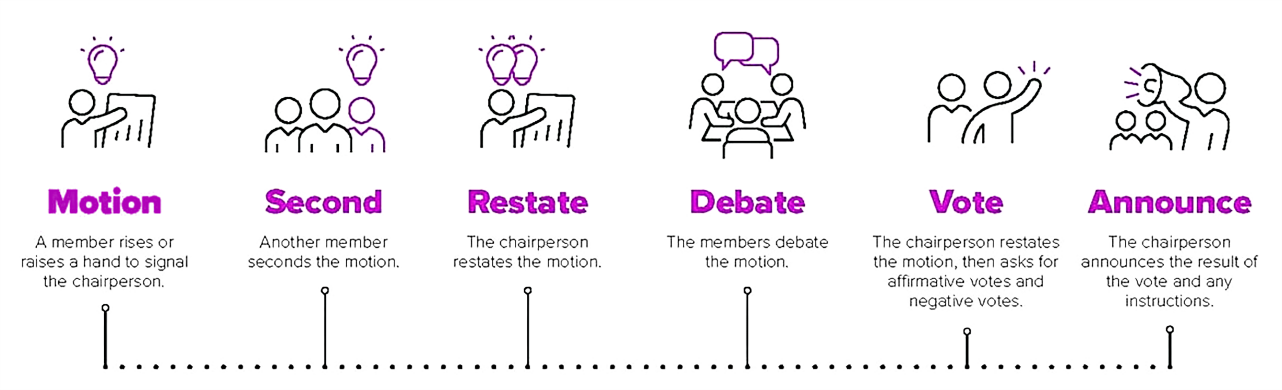

Motions and Voting
Motion and Vote
1. Propose Motion
2. Second the Motion
3. Chair States the Motion
4. Discussion
5. (Optional) Amendment
6. Vote
7. Announce Results
Source: Robert, H. M., Evans, W. J., Honemann, D. H., & Balch, T. J. (2020). Robert's Rules of Order Newly Revised (12th ed.). Public Affairs.

Slide 24

Brown Act
What is Brown Act?
Enacted in State Legislature in 1953
Government Code Section 54950 requires public agencies to conduct business in open forums, with limited exceptions
Applies to:
  Bodies created by formal action of a local legislative body (i.e., Commissions, Committees, Councils, etc.)
  Standing Committee” which has jurisdiction over a particular subject matter or with a fixed meeting schedule
Does not apply to ad hoc
  Limited term, and not a standing meeting
Quorum is required to conduct public meeting
  Quorum is 50% of members or alternates
The Brown Act
AKA the Sunshine Law

Slide 25

LA County ECE Unified Strategic Plan 2026-2030
Development of Strategic Plan will be informed by:
Child Care Planning Committee
Policy Roundtable Commission
OAECE
ECE Providers
Parents
Public
Reports
  UPK Implementation Plan
  Blueprint to Fortify the ECE Infant and Toddler System
  LA County ECE Needs Assessment 2023
  LA County’s Health Survey
  etc.
25

Slide 26

LA County ECE Unified Strategic Plan 2026-2030
Key Roles
Child Care Planning Committee (CCPC)
Leads and oversees the development of the Strategic Plan
Approves the Strategic Plan
Submits Strategic Plan to CA Department of Education (CDE)
Policy Roundtable Commission
Provide policy recommendations to include in the Strategic Plan
OAECE
Manage the process to develop the Strategic Plan
Obtain Department of Public Health approval
Facilitate the submission of Strategic Plan to CDE
Provide staffing support and other resources needed to develop the Strategic Plan
Contractor (Estolano Advisors)
Conduct outreach and gather input from parents and ECE providers and other stakeholders
Provide recommendations for the Child Care Planning Committee to consider based on input gathered
Update recommendations and draft the final Strategic Plan for Child Care Planning Committee to approve
26

Slide 27
LA County ECE Unified Strategic Plan 2026-2030
Planning Process 2025-26
September 2025
Project launch; structure & goals set
February 2026
Share parent & ECE provider input and findings with CCPC
April 2026
PRT approves policy recs, CCPC approves final content
May 2026
Strategic Plan approved by committees and submitted to State.
LPC chairs review and finalize Strategic Plan
June 2026
October –January 2025
Gather broad input from providers and parents via surveys, focus groups, and listening sessions.
February- March 2026
Refine plan framework based on input and findings
27

Slide 28

Questions
Questions, Comments, and Reflections:
Comments from Councilmembers
Comments from the Public
28
28

Slide 29
Proposed Ad Hoc
Governance Ad Hoc
To oversee the Planning Committee governance and reporting processes, as well as to review proposed changes to Policies and Procedures
Strategic Plan Ad Hoc:
To guide the development of the LA County ECE Strategic Plan 2025-2030.
Family Access Ad Hoc:
To inform strategies to increase families’ access to early care and education services, especially for children 3 and 4 years old.
Workforce Ad Hoc:
To support planning for the early care and education workforce, especially those serving preschool age children.
Special Needs Ad Hoc:
To advise on the inclusion of children at risk for disabilities or with special needs in early care and education environments that are the least restrictive.
29

Slide 30

Consent Calendar
Consent Calendar
8A. Vote to Approve Meeting Minutes from June 4, 2025
8B. Vote to Establish Governance Ad Hoc
8C. Vote to Establish Strategic Planning Ad Hoc
8D. Vote to establish Family Access Ad Hoc
8E. Vote to establish UPK Workforce Ad Hoc
8F. Vote to establish Special Needs Ad Hoc
30

Slide 31
Child Care Use and Barriers in LA County
Los Angeles County Health Survey:
2018 and 2023
LA County Child Care Planning Committee
September 3rd, 2025
31
Notes:
Good morning and welcome to our first presentation of data from the Medi-Cal/HMIS Matched data project. My name is Will Nicholas. I direct the Center for Health Impact Evaluation at the LA County Department of Public Health. I am joined today by members of my team as well as representatives from our distinguished partners on this project from the Los Angeles County Chief Information Office and the Los Angeles Homeless Services Authority. I would also like to thank the California Department of Health Care Services for all their help in getting us to where we are today, including their performance of the actual data match and their diligence in ensuring that the data use agreements between the three partners organizations remain valid and up to date so that the work can continue.

Slide 32
Unpublished data slides have been removed

Slide 33

Announcements and Public Comment
Announcements
and
Public Comment
33

Slide 34



Call to Adjourn
See you at our next meeting
Wednesday, November 5, 2025 !
LA County Office of Education
10100 Pioneer Blvd., Conference Room 110-111, Santa Fe Springs, CA 90670
childcare.lacounty.gov
34
34

