Slide 1



Public Hearing Local Child Care and Development Planning Council Local Funding Priorities for California Early Care and Education Programs April 1, 2026
Notes:
LPCs are mandated to send updated LPC Local Funding Priorities to the CDE each year
The priorities are used by the CDE to make decisions on funding allocations for subsidized ECE services as new monies become available in the state budget
CDE issues a RFA with instructions to applicants to address the communities they plan to serve with reference to the LPC Local Funding Priorities
CDE then makes funding decisions that begin with applicants planning to serve priority 1 zip codes and then works its way down the to priority 2 – rarely, if ever, does it make it to a priority 3 zip code
The priorities also are used to support requests to expand service areas (FCCHENs) with existing contracts or when a contractor needs to relocate the center-based services, for example, due to the end of a lease.
Recently reminded – usefulness locally when approaching philanthropy for funding to augment program services or persuading Boards of organizations

Slide 2
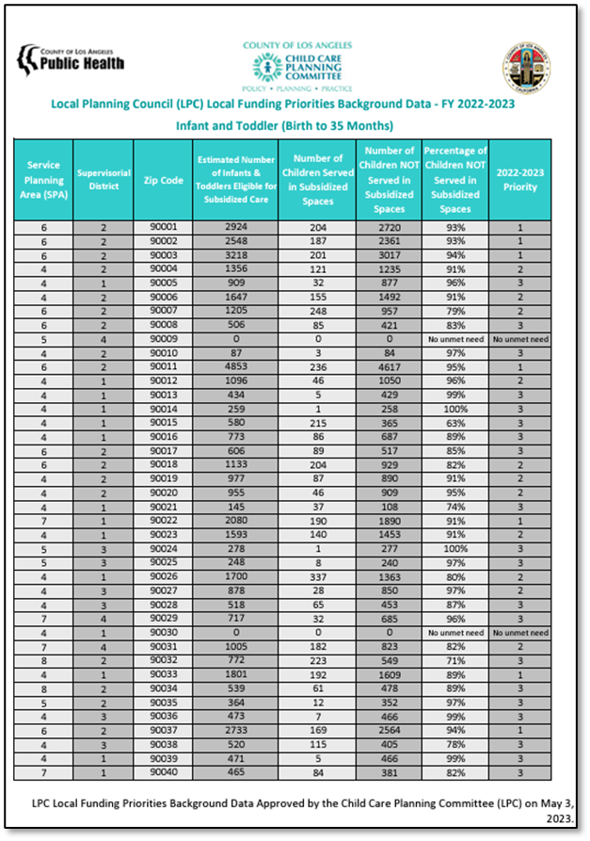

LOCAL FUNDING PRIORITIES
What is it?
Compares the number of LA County children income eligible* for subsidized early care and education services, to the number of children enrolled in subsidized/publicly funded early care and education
Separated by zip code & age group
How is it used?
State departments consider the report when distributing funding to promote equal access to child development services
Local Planning Councils elevate for strategic planning
Early care and education providers utilize to apply for funding
Programs prioritize services based on report
Excel and PDF reports are available at childcare.lacounty.gov/lpc/#activities
*Management Bulletin 15-04. Local Child Care and Development Planning Council Funding Priority Setting Process. June 2015. Available at https://cdss.ca.gov/inforesources/child-care-and-development/quality-improvement-initiatives/local-child-care-and-development-planning-councils/management-bulletin-15-04

Slide 3


SHIFTS IN DATA COLLECTION
Previous Data Collection
American Institute of Research collected data in ELNAT for every county
ENAT has been discontinued
New Data Collection in LA County
Created LA County ECE Data Collaborative
LA County Office for the Advancement of Early Care and Education
LA County Public Health Center for Health Impact Evaluation
Universal Preschool UC Berkeley Equity & Excellence in Early Childhood
Los Angeles County Office of Education
Child Care Alliance of Los Angeles
First 5 LA

Slide 4
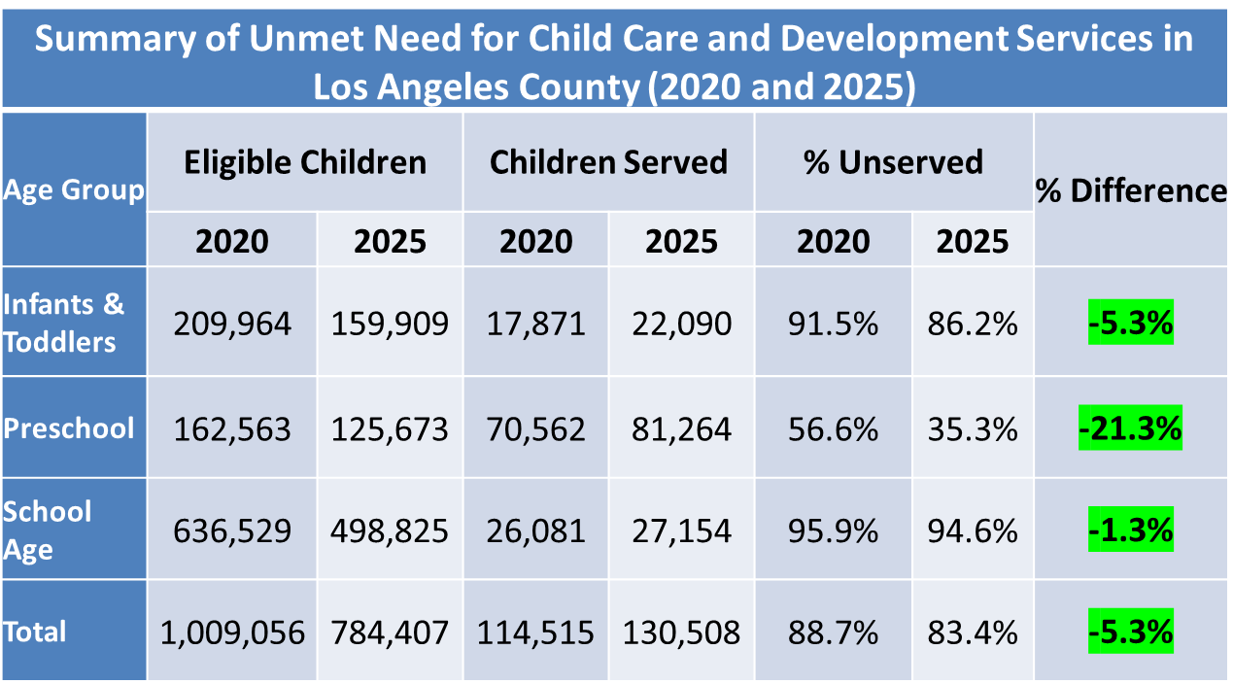
SNAPSHOT OF ELEIGIBLE CHILDREN SERVED

Slide 5
PRIMARY ELEMENTS OF CHILD CARE FUNDING PRIORITY ASSESSMENT
Zip Code-level populations of eligible children by age group
Total child population estimates by age group
Percent of children eligible for age-specific programs
Zip Code-level numbers of children enrolled in ECE programs
Annual point-in-time enrollment data from providers
Zip Code-level unmet need for ECE by age group
Subtract enrollment numbers from estimated numbers of eligible children; calculate precent of eligible children not enrolled (unmet need)
Assign funding priority levels to Zip Codes based on State Criteria
Zip Codes with highest unmet need are assigned highest funding priority level

Slide 6
CHILD POPULATION DATA
Why we use birth data rather than US Census American Community Survey (ACS) 5-year population data
LA County Birth Rates have been declining rapidly over the past 5 years
So, ACS five-year averages overestimate the true population
The Census typically undercounts lower-income and other hard to reach households (birth records count all births)
Based on actual comparison, ACS population estimates for ages 3-4 are higher than birth-based estimates in higher income Zip Codes. So, using birth data promotes equity in the prioritization process

Slide 7
INCOME ELIGIBILITY THRESHOLDS
California State Median Income for a family of 4 is $122,993
California uses State Median Income (SMI) as primary criterion
<=100% SMI for California State Preschool Program (CSPP)
<=85% SMI for other programs
TK is free but we only count enrollees who are socioeconomically disadvantaged
Using Census data for Zip Code population eligibility requires SMI conversion to Federal Poverty Level (FPL)
<=100% SMI ≈ <=400% FPL; <=85% SMI ≈ <=335% FPL
Based on family size of 4
So……
Children 0-2 and 5-12: our eligibility threshold is <=335% of FPL
Children 3-4: our eligibility threshold is <=400% of FPL

Slide 8
ENROLLMENT DATA
OAECE Survey of Contracted Licensed Providers (Spring 2025)
Contracted provider enrollments in HS/EHS, CFCC, CCTR and CSPP by setting, age, and length of day
Data Provided by the Child Care Alliance of LA (Spring 2025)
Voucher-based enrollments in CalWORKS Stages 1,2, and 3 and CAPP, by setting (Center-based and FCCH) and age
TK Data from California Department of Education
TK enrollment data for children with socioeconomic disadvantage
Note on ZIP CODE-Level Enrollment Data
Only a Few Programs Provide Enrollment Data by Zip Code of Child Residence; All Provide Data by Zip Code of Provider Site
For comparability we report by provider site, but population data is based on residence
Thus, a few Zip Codes show more enrollees than eligible children (negative unmet need). All coded as “No unmet need”.
Notes:
California Department of Education (CDE) and other zip code data to determine number and percent of eligible children served or not served by State funded programs as well as Head Start or Early Head Start
In past, CDE conducted a special run of 801A data for LPCs: CCTR, CSPP, AP, CalWORKs Stages 2 and 3, FCCHENs
Zip Code by Age. Now that data is provided to AIR.
Population estimates projected for 2014 - three-year-averages up to 2012, five-year in 2014, from American Community Survey), source: AIR analysis of American Community Survey, Public Use Microdata Sample (PUMS) data three-year data file 2010-2012
CDD-801A is the list of all families and children that received EESD-subsidized services for a specified month. It is submitted monthly by every agency that contracts with EESD to provide subsidized child care and development services.

Slide 9
NEGATIVE UNMET NEED
Infants and Toddlers
3 Zip Codes with negative unmet need; none have 500+ children 0-2.
Preschool Age
42 Zip Codes with negative unmet need; 4 have 500+ children 3-4.
91340 (San Fernando); 90043 (View Park/Windsor); 90806 (Long Beach); 91770 (Rosemead)
School Age
2 Zip Code with negative unmet need; none have 500+ children 5-12.
Notes:
California Department of Education (CDE) and other zip code data to determine number and percent of eligible children served or not served by State funded programs as well as Head Start or Early Head Start
In past, CDE conducted a special run of 801A data for LPCs: CCTR, CSPP, AP, CalWORKs Stages 2 and 3, FCCHENs
Zip Code by Age. Now that data is provided to AIR.
Population estimates projected for 2014 - three-year-averages up to 2012, five-year in 2014, from American Community Survey), source: AIR analysis of American Community Survey, Public Use Microdata Sample (PUMS) data three-year data file 2010-2012
CDD-801A is the list of all families and children that received EESD-subsidized services for a specified month. It is submitted monthly by every agency that contracts with EESD to provide subsidized child care and development services.

Slide 10
FAMILY, FRIEND, AND NEIGHBOR CARE
CCALA has provided data on voucher-based FFN care at provider zip code level
Many families using vouchers for FFN care ALSO use other types of care
So, including FFN numbers would double-count some children served and lower priority levels for some zip codes
Difficult to separate those ONLY using FFN for unduplicated counts
Zip Code-level data on FFN care are available for those interested
Notes:
California Department of Education (CDE) and other zip code data to determine number and percent of eligible children served or not served by State funded programs as well as Head Start or Early Head Start
In past, CDE conducted a special run of 801A data for LPCs: CCTR, CSPP, AP, CalWORKs Stages 2 and 3, FCCHENs
Zip Code by Age. Now that data is provided to AIR.
Population estimates projected for 2014 - three-year-averages up to 2012, five-year in 2014, from American Community Survey), source: AIR analysis of American Community Survey, Public Use Microdata Sample (PUMS) data three-year data file 2010-2012
CDD-801A is the list of all families and children that received EESD-subsidized services for a specified month. It is submitted monthly by every agency that contracts with EESD to provide subsidized child care and development services.

Slide 11
STATE ZIP CODE PRIORITY SETTING CRITERIA
Priority 1: Zip code qualifies when there are 50% or more eligible children unserved AND more than 1,500 eligible children unserved
Priority 2: Zip code qualifies when there are 50% or more eligible children unserved AND more than 750 eligible children unserved
Priority 3: Zip code qualifies when there are 50% or more eligible children unserved AND more than 500 eligible children unserved
Another option is to count all other Zip Codes with any unmet need as priority 3

Slide 12
OVERVIEW OF FINDINGS: INFANTS AND TODDLERS
 | Programs Serving Infants and Toddlers
Service Planning Area | Number of Zip Codes with Priority Ratings
 | 1 | 2 | 3 | Prioritized Zip Codes | Total Zip Codes
SPA 1 (Antelope Valley) | 1 | 3 | 1 | 5 | 15
SPA 2 (San Fernando) | 3 | 6 | 9 | 18 | 71
SPA 3 (San Gabriel Valley) | 2 | 7 | 5 | 14 | 54
SPA 4 (Metro) | 0 | 8 | 2 | 10 | 34
SPA 5 (West) | 0 | 0 | 0 | 0 | 30
SPA 6 (South) | 7 | 5 | 4 | 16 | 22
SPA 7 (East) | 4 | 5 | 5 | 14 | 34
SPA 8 (South Bay) | 1 | 8 | 9 | 18 | 45
Totals | 18 | 42 | 35 | 95 | 305
Notes:
Clusters of zip codes with significant need, but do not meet threshold – cumulatively, show significant unmet need. How are we serving the larger communities not identified as highest need when looking only at zip code level data. What questions does this raise?

Slide 13
OVERVIEW OF FINDINGS: Preschool-Age Children
 | Programs Serving Preschool-Aged Children
Service Planning Area | Number of Zip Codes with Priority Ratings
 | 1 | 2 | 3 | Prioritized Zip Codes | Total Zip Codes
SPA 1 (Antelope Valley) | 0 | 1 | 0 | 1 | 15
SPA 2 (San Fernando) | 0 | 1 | 1 | 2 | 71
SPA 3 (San Gabriel Valley) | 0 | 0 | 3 | 3 | 54
SPA 4 (Metro) | 0 | 0 | 1 | 1 | 34
SPA 5 (West) | 0 | 0 | 0 | 0 | 30
SPA 6 (South) | 0 | 3 | 0 | 3 | 22
SPA 7 (East) | 0 | 0 | 1 | 1 | 34
SPA 8 (South Bay) | 0 | 0 | 1 | 1 | 45
Totals | 0 | 5 | 7 | 12 | 305
Notes:
Clusters of zip codes with significant need, but do not meet threshold – cumulatively, show significant unmet need. How are we serving the larger communities not identified as highest need when looking only at zip code level data. What questions does this raise?

Slide 14
OVERVIEW OF FINDINGS: School-Age Children
 | Programs Serving School-Age Children
Service Planning Area | Number of Zip Codes with Priority Ratings
 | 1 | 2 | 3 | Prioritized Zip Codes | Total Zip Codes
SPA 1 (Antelope Valley) | 5 | 2 | 0 | 7 | 15
SPA 2 (San Fernando) | 18 | 13 | 16 | 47 | 71
SPA 3 (San Gabriel Valley) | 19 | 18 | 7 | 44 | 54
SPA 4 (Metro) | 13 | 10 | 1 | 24 | 34
SPA 5 (West) | 0 | 4 | 1 | 5 | 30
SPA 6 (South) | 18 | 2 | 0 | 20 | 22
SPA 7 (East) | 15 | 10 | 5 | 30 | 34
SPA 8 (South Bay) | 17 | 9 | 3 | 29 | 45
Totals | 105 | 68 | 33 | 206 | 305
Notes:
Clusters of zip codes with significant need, but do not meet threshold – cumulatively, show significant unmet need. How are we serving the larger communities not identified as highest need when looking only at zip code level data. What questions does this raise?

Slide 15
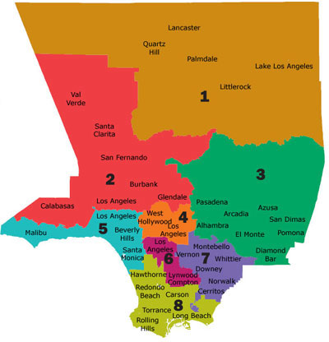
LA County Service Planning Areas

Slide 16

PUBLIC COMMENT
Comments, Questions, and Reflections

