Slide 1



Child Care Planning Committee
Los Angeles County
Local Child Care and Development Planning Council (LPC)
Wednesday, September 2, 2026
12:00 p.m. to 2:30 p.m.

Slide 2

Welcome and Introductions
Vision Statement
Children are healthy, thriving and have equitable opportunities to achieve optimal development and succeed in life.
Mission Statement
Lead, build, and strengthen an affordable and high-quality early care and education system for the children and families of Los Angeles County.
2

Slide 3


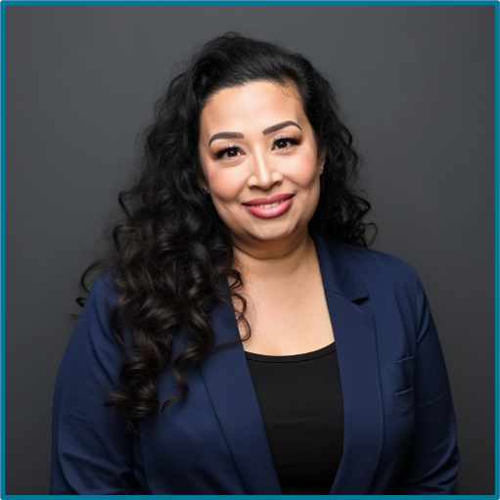
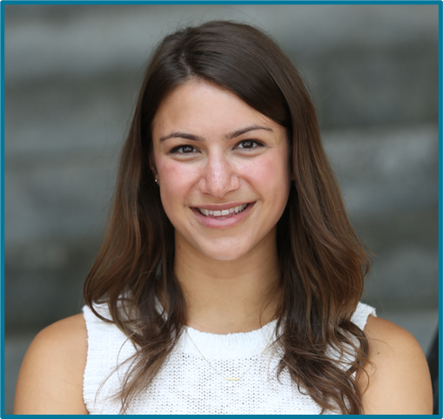
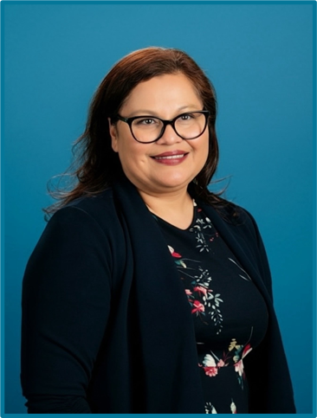

LPC Leadership
Chair
First Vice Chair
Second Vice Chair
Andrea Fernandez Mendoza
Rachel Bocarsly
Christina Moore

Slide 4

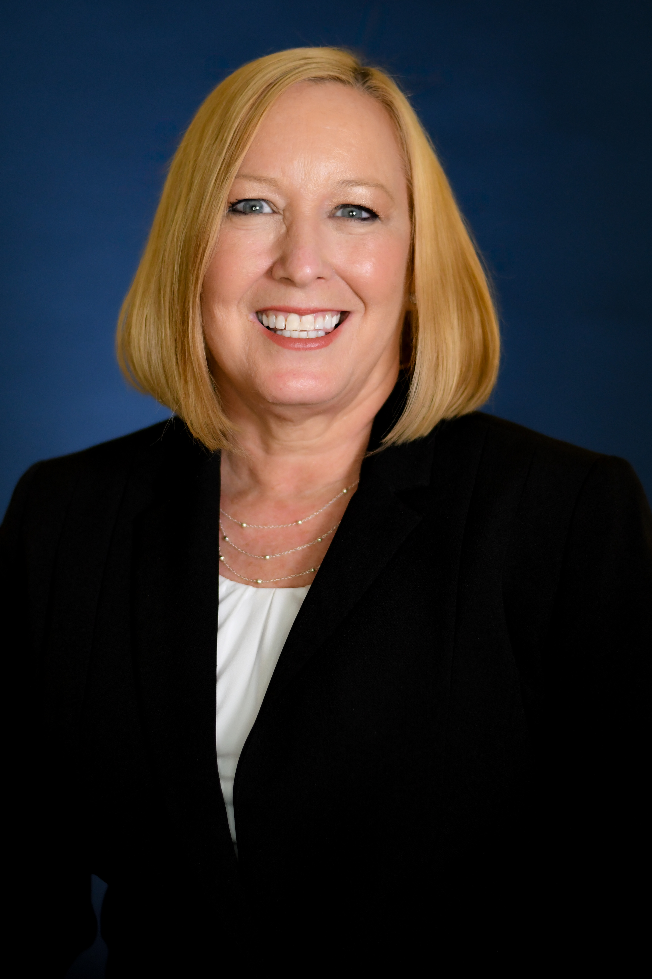


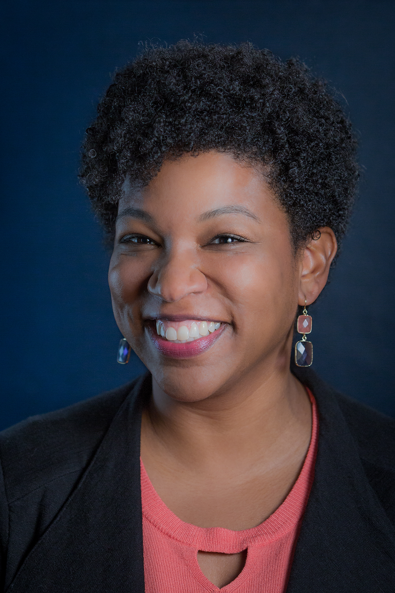
OAECE LPC/UPK Staff
OAECE Director
LPC Coordinator
UPK Research Specialist
UPK Program Specialist
Debra Colman
Simone Taylor
Sheronda Helton
Maryam Diaab

Slide 5

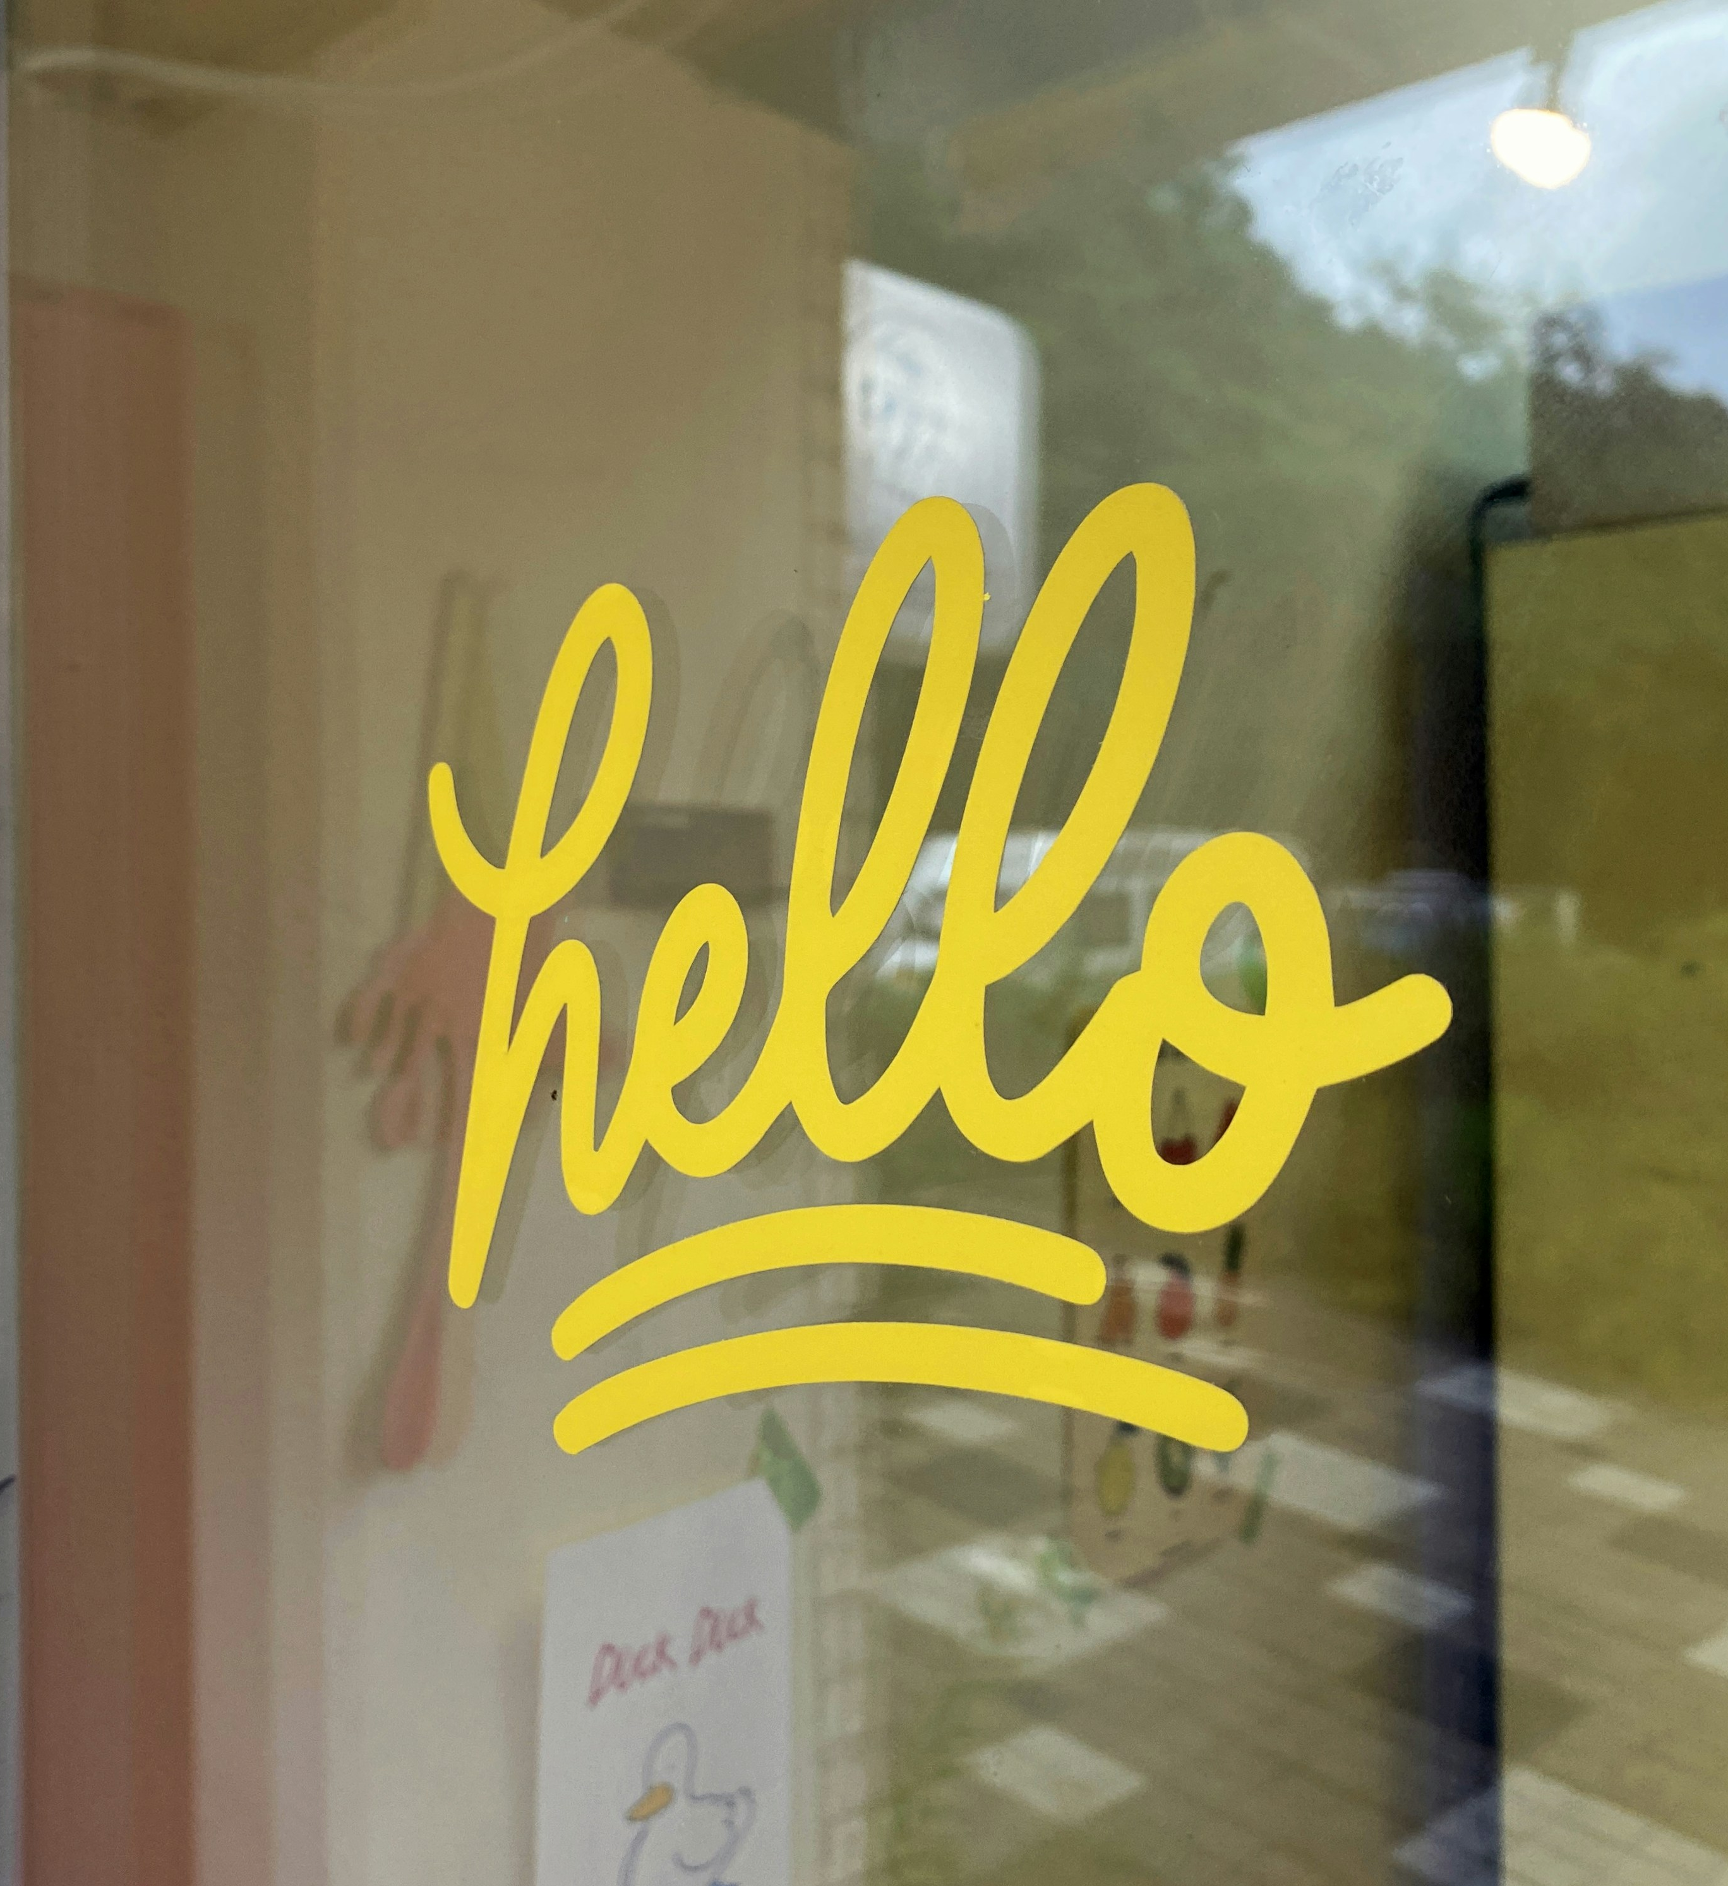


Welcome and Introductions
Please share your:
Name
Role as a Child Care Planning Committee Member, Alternate, or Guest
Organization or Affiliation, if it applies
5

Slide 6
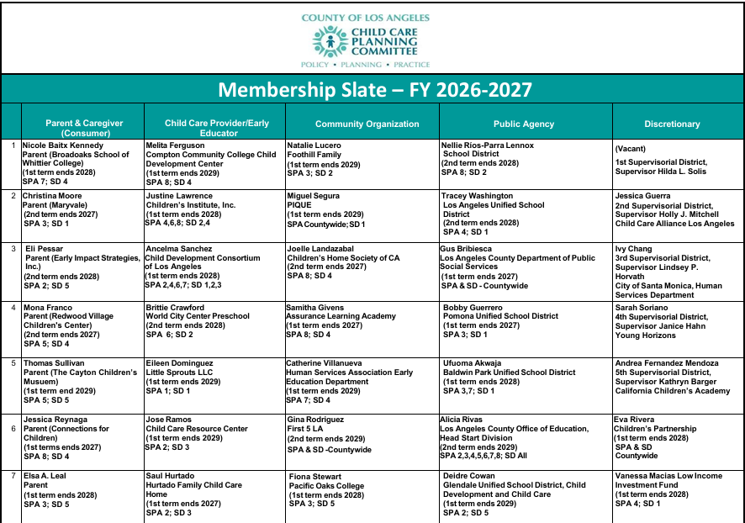
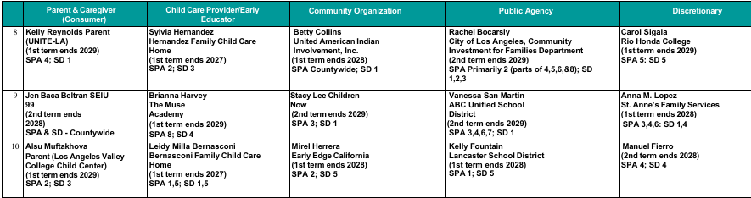



























































































































































































Councilmember Presentation of Appointments
Los Angeles County Child Care Planning Committee (Local Planning Council) Fiscal Year 2026-2027
6

Slide 7


Comments from the Chair
Vision for the FY 26-27 Child Care Planning Committee
- Comments from the Chair

Slide 8
Key Responsibilities of the Planning Committee
Complete the LPC Local Funding Priorities and certify membership annually
Coordinate the Voluntary Temporary Transfer of Funds process
Provides input on policy issues through the Joint Committee on Legislation
Develop a Child Care Needs Assessment every five years
Develop countywide ECE strategic plan every five years
Plan for Universal PreKindergarten Mixed Delivery System
8
Notes:
I would like to spend a few minutes highlighting some of the key responsibilities of the Child Care Planning Committee.
Again, the Child Care Planning Committee is LA County’s Local Planning Council. I will use the terms interchangeably.
Both the funding priorities & voluntary transfer of funds are done annually, and every five years we produced the ECE Needs Assessment and a new strategic plan.
The policy priorities and legislative agenda are updated as needed.

Slide 9

Responsibility #1: Voluntary Temporary Transfer of Funds
Temporary transfer of funds between ECE contracts from the California Department of Education or the California Department of Social Services
  Available for programs that may be under- or over-earning their contracts
  Ensures that funds are retained within LA County
Eligible Programs
  General Child Care and Development (CCTR)
    Includes CCTR administered Family Child Care Home Education Networks (FCCHEN)
  Family Child Care Home Education Network (CFCC)
  Alternate Payment Program (CAPP)
  California State Preschool Program (CSPP)
Timeline
  Fall – October/November 2026
  Spring – April/May 2027
9

Slide 10
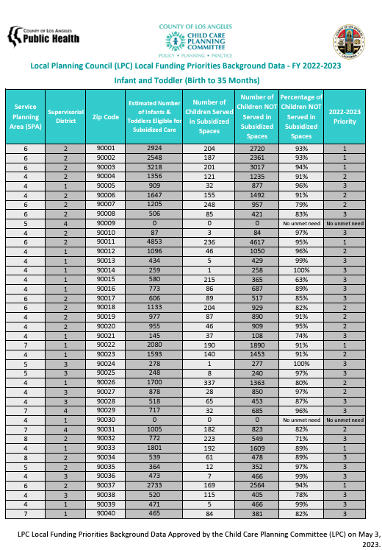
Responsibility #2: Local Funding Priorities
What is it?
Compares the number of LA County children income-eligible* for subsidized early care and education services, to the number of children enrolled in subsidized early care and education
  *Separated by zip code & age group
How is it used?
State departments consider the report when distributing funding to promote equal access to child development services
Excel and PDF reports are available at childcare.lacounty.gov/lpc/#activities
*Management Bulletin 15-04. Local Child Care and Development Planning Council Funding Priority Setting Process. June 2015. Available at https://cdss.ca.gov/inforesources/child-care-and-development/quality-improvement-initiatives/local-child-care-and-development-planning-councils/management-bulletin-15-04
10

Slide 11

Responsibility #3: ECE Strategic Plan
Early Care and Education (ECE) Strategic Plan
Comprehensive countywide plan
Developed every five years
Current Strategic Plan
- Access
- Quality
- Workforce
- Families and Communities
  New strategic planning is coming for approval at the November Child Care Planning Committee meeting
11

Slide 12





Responsibility #4: Universal PreKindergarten
Universal PreKindergarten (UPK) Mixed Delivery Planning Grant
Goal 1: Increase parents’ knowledge about their early education choices
Goal 2: Strengthen partnerships between school districts and ECE mixed delivery systems
Goal 3: Enhance partnerships to support children with special needs
Goal 4: Increase supports for UPK workforce
12

Slide 13
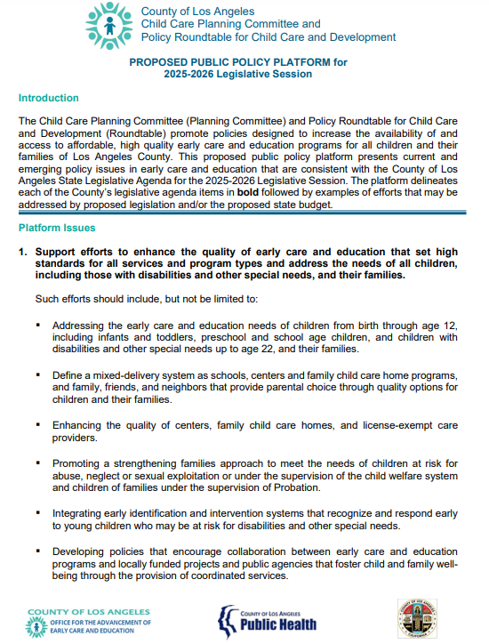
Responsibility #5: Joint Committee on Legislation
Standing Committee
  - Held under Brown Act and meets in person
Appointees
  - 4 appointees from Child Care Planning Committee
  - 4 appointees from Policy Roundtable for Child Care and Development (Policy Roundtable)
Purpose
  - Discusses the State and Federal budget
  - Analyzes proposed State and Federal legislation
  - Informs positions on ECE issues which are approved by the Policy Roundtable.
13

Slide 14

Roles and Responsibilities FY 26-27
?
?
?
?
Questions:
Comments from Councilmembers
Comments from the Public
14

Slide 15
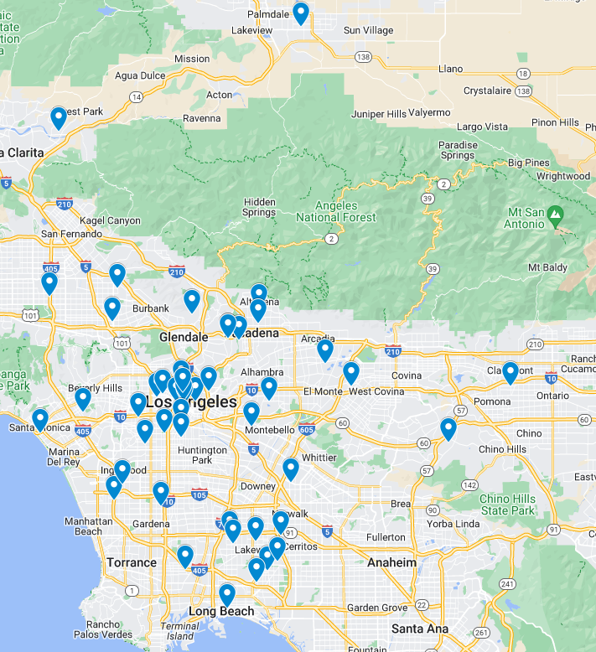
Child Care Planning Committee/LPC Overview
Planning Committee/LPC Member Representation in Los Angeles County
Welfare and Institutions Code
    20% shall be consumers (parents and caregivers)
    20% shall be child care providers
    20% shall be public agency representatives
    20% shall be community representatives
    20% shall be at the discretion of the appointing agencies
Governing Process
    Chair, First Vice Chair, Second Vice Chair
    Robert’s Rules of Order
    Brown Act
15

Slide 16

Robert’s Rules of Order
What it is
  Guide to conducting meetings and making decisions as a group
How it works
  A decision is carried out through a motion, which is a proposal to do something
Who is involved
  A member may propose a motion or vote
  An alternate may act in the role of a member if the member is not present

Slide 17
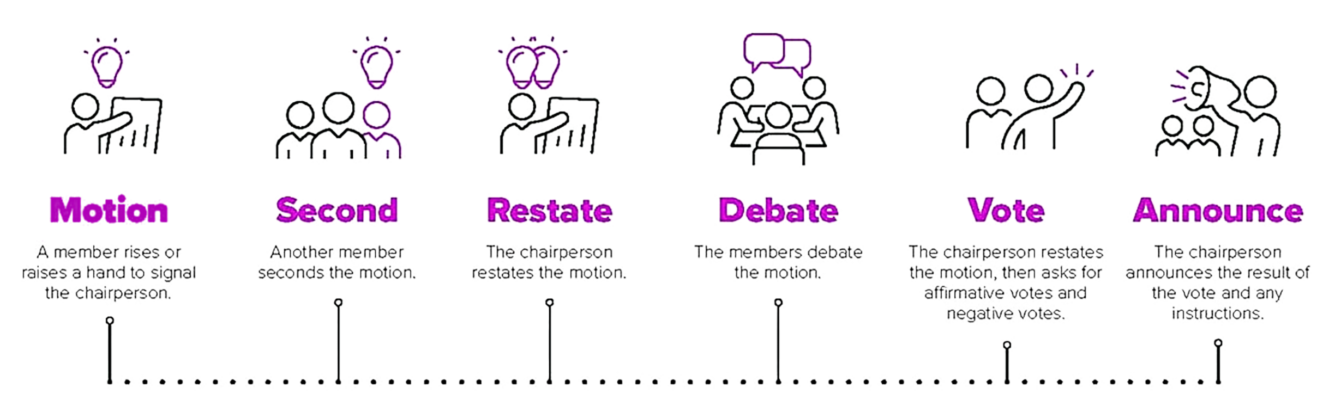
Motions and Voting
Motion and Vote
1. Propose Motion
2. Second the Motion
3. Chair States the Motion
4. Discussion
5. (Optional) Amendment
6. Vote
7. Announce Results
Source: Robert, H. M., Evans, W. J., Honemann, D. H., & Balch, T. J. (2020). Robert's Rules of Order Newly Revised (12th ed.). Public Affairs.

Slide 18

Brown Act
What is Brown Act?
Enacted in State Legislature in 1953
Government Code Section 54950 requires public agencies to conduct business in open forums, with limited exceptions
Applies to:
  Bodies created by formal action of a local legislative body (i.e., Commissions, Committees, Councils, etc.)
  Standing Committees which has jurisdiction over a particular subject matter or with a fixed meeting schedule
Does not apply to ad hoc
  Limited term, and not a standing meeting
Quorum is required to conduct public meeting
  Quorum is 50% of members or alternates
The Brown Act
AKA the Sunshine Law

Slide 19
2026 Revisions to Brown Act
  Language Access
  The public must have access to interpretation in other languages.
  Contact the LPC Coordinator the week prior to the meeting to request interpretation.
  Teleconferencing
  Teleconferencing is available for councilmembers and the public.
  Quorum can only be obtained by the number of people physically attending the meeting - Councilmembers attending via teleconference do not count toward quorum.
  If teleconferencing is disrupted, the meeting must stop until the service is restored.
  If the service cannot be restored, the body must vote to determine if good-faith efforts were made to restore service to be able to continue the meeting.
  Councilmembers unable to attend in person due to a qualifying Just Cause reason must provide advance notification to LPC Coordinator as soon as possible. This notification must include the specific Just Cause reason for participation via Teleconference.

Slide 20
2026 Revisions to Brown Act – Just Cause
  There must be a “Just Cause” for a councilmember to participate via Teleconference:
  1. Child care or caregiving need of a child, parent, grandparent, grandchild, sibling, spouse, or domestic partner that requires them to participate remotely
  2. A contagious illness that prevents a member from attending in person
  3. A need related to a physical or mental condition that meets certain criteria
  4. Travel while on official business of the Policy Roundtable, Planning Committee, JCL or another government agency
  5. An immunocompromised child, parent, grandparent, grandchild, sibling, spouse, or domestic partner of the member that requires the member to participate remotely
  6. A physical or family medical emergency that prevents a member from attending
  7. Military service obligations that result in a member being unable to attend in person because they are serving on official military service at least 50 miles outside the boundaries of LA County

Slide 21

What is an Ad Hoc
A temporary body created to tackle a specific problem, project, or decision
  Meetings take place on an as needed basis
  Participation is limited to Councilmembers and Alternates
  Only one ad hoc per individual
  Participants are expected to attend and actively participate in all ad hoc meetings
21

Slide 22
Proposed Ad Hocs for FY 26-27
Governance Ad Hoc - Advises on governance, reporting processes, and changes to the policies and procedures
School Partnership Ad Hoc - Informs Universal PreKindergarten strategies to strengthen partnerships between local education agencies (school districts and charter schools) and the early care and education mixed delivery system
Family Access Ad Hoc - Guides approaches to increase family access to early care and education services, especially as a part of Universal PreKindergarten
Workforce Ad Hoc - Advises on early care and education workforce issues, especially on matters connected to early educators serving children 3-4 years olds as a part of Universal PreKindergarten
Special Needs Ad Hoc - Informs strategies on the inclusion of children 3 and 4 years old at risk for disabilities or with special needs in early care and education environments that are the least restrictive
22

Slide 23

Consent Calendar
Consent Calendar
7A. Vote to Approve Meeting Minutes from June 3, 2026
7B. Vote to Establish Governance Ad Hoc
7C. Vote to Establish School Partnership Ad Hoc
7D. Vote to Establish Family Access Ad Hoc
7E. Vote to Establish UPK Workforce Ad Hoc
7F. Vote to Establish Special Needs Ad Hoc
23

Slide 24


Strategic Plan Overview Agenda
Updates on the Structure of the LA County Early Care and Education (ECE) Strategic Plan 2026-30
Overview of LA County ECE Strategic Plan 2026-30
Council Member Discussion
Public Comment
Next Steps
Notes:
Debra Colman or Andrea Fernandez Mendoza
Today, we will spend our time doing the following:
Introduction from Child Care Planning Committee Chair (5 min)
Updates on the Structure of the LA County Early Care and Education (ECE) Strategic Plan 2026-30 (5 min)
Overview of LA County ECE Strategic Plan 2026-30 (15 min)
Discussion (20 min)
Public Comment (10 min)
Next Steps (5 min)

Slide 25
LA County ECE Strategic Plan 2026-30 Planning Process
September 2025
Established Strategic Plan Ad Hoc
January - April 2026
Strategic Plan Ad Hoc met four times
February, April, & June 2026
Provided input to Strategic Plan Priority Areas and Recommendations
Summer 2026
Review, refine, and approve Strategic Plan
Continue additional research and prepare full Strategic Plan for Committee’s review
Fall 2026
September 2025 to
April 2026
November 2025
& May 2026
Reviewed data
Gathered input from Policy Roundtable
We are here
25
Notes:
Include in Facilitation Agenda
Examples for Eli to highlight for data: LA County Healthy Families Survey, Berkely Workforce Study, Berkely & LA County Access data (provide exact names of studies)

Slide 26
Purpose of LA County ECE Strategic Plan 2026-30
WIC Code Requirement:
“Prepare a comprehensive countywide child care plan designed to mobilize public and private resources to address identified needs.”
What It is:
A high-level plan for the early care and education system across LA County
Sets a “North Star” and springboard to unify early care and education stakeholders
What It Is Not:
It is not OAECE’s strategic plan
The strategic plan is not an implementation plan
Government Council Guardrails:
Child Care Planning Committee is a government council, not an advocacy coalition
Council has a role to educate, plan, and promote systems improvement strategies
Notes:
What it is
A plan developed by the Local Child Care and Development Planning Council is required every 5 years by CA Welf & Inst Code § 10486:
“Prepare a comprehensive countywide child care plan designed to mobilize public and private resources to address identified needs.”
What it is not:
OAECE's strategic plan
How it is used:
Guides public and private investments in the ECE system, informs policy priorities at a local, state, and federal level, and serves as a framework to unify ECE system across LA County.

Slide 27


Goals and Example Strategies
EXAMPLE STRATEGY
An idea that demonstrates a way
to obtain the goal.
Engage private sector organizations, like the
Chambers of Commerce, as partners in ECE workforce
GOAL
What the Strategic Plan would like to change
Align, expand and strengthen ECE pathways for recruiting and preparing new early educators.
PRIORITY AREA
Key focus that guides the strategic plan
ECE Workforce
Notes:
Raahi Reddy
For the development of the DRAFT 2026-30 Strategic Plan, we synthesized the Ad Hoc’s input, continued external research, and consulted with stakeholders across the field. From this work, we present three key priority areas that will help provide strategic focus on our efforts to lift up the early care and education sector and families in LA County over the next five years.
Each of these priorities are relevant and achievable, and the Strategic Plan distinguishes between overarching outcomes and actionable pathways.
A Goal defines the explicit, long-term change the Strategic Plan aims to achieve within the ECE system.
An Example Strategy provides an idea or approach demonstrating how to achieve that goal.
Here is an overview of the priority areas and goals for the Strategic Plan 2026-30.
Priority Area 1: ECE Workforce
Goal 1.A. Promote increased compensation for the early care and education workforce.
Goal 1.B. Expand access and awareness of workplace well-being strategies that promote mental health of ECE workforce and address external stressors in the workplace.
Goal 1.C. Align, expand and strengthen ECE pathways for recruiting and preparing new early educators.
Priority Area 2: Access to ECE
Goal 2.A. Strengthen and simplify access to ECE programs for Los Angeles County families.
Goal 2.B. Build partnerships that connect the ECE system with other systems that support families with young children.
Goal 2.C. Expand financial investments in ECE programs to support the sustainability of child care services.
Goal 2.D. Expand access to publicly available, user-friendly tools and data resources that support local planning for ECE expansion.
Priority Area 3: ECE Infrastructure
Goal 3.A. Strengthen, streamline and simplify ECE facility development across Los Angeles County.
Goal 3.B. Increase ECE facility renovation and/or development for programs that serve infants and toddlers.
Goal 3.C. Improve connections between ECE providers and operational resources that help reduce program costs and support business sustainability.
Goal 3.D. Elevate the importance of ECE as a priority in Los Angeles County municipalities.

Slide 28
How to Use This Plan
The LA County ECE Strategic Plan 2026-30 is a guiding framework for LA County’s ECE system.
Successful implementation requires active participation from every stakeholder group.
Early Educators
Families
Community Organizations
Systems Leaders
Elected Officials
Business Leaders
Philanthropy
School Districts
Unify Approaches
Empower Families
Guide Planning
Inform Policy
Influence Leadership
Engage Philanthropy
28
Notes:
Raahi Reddy
This Strategic Plan serves as a guiding framework for Los Angeles County’s ECE system, a north star for the progress we hope to achieve, fostering strategic collaboration.
While the Planning Committee worked together to design Priority Areas, Goals and provide Example Strategies, a central component of this framework is the shared responsibility for the Child Care Planning Committee to implement the Strategic Plan.
Successful implementation requires active participation from every stakeholder group. Early educators, families, community organizations, alongside systems leaders, elected officials, business leaders, philanthropy, and school districts each hold an essential role in mobilizing resources, building partnerships, and advancing the Strategic Plan’s core goals.
Stakeholders can leverage this framework to:
Build a Unified Voice: Share with early educators, child care providers, and practitioners to align regional priorities.
Empower Family Advocacy: Equip parents and families with the tools and information needed to advocate effectively for the ECE system.
Guide Organizational Planning: Serve as a foundational resource for community-based organizations during strategic planning and program design.
Inform Policy and Legislation: Provide elected officials and policy makers with strategies to elevate local, state, and federal legislation.
Drive Municipal Leadership: Present to municipal leaders and local cities examples of how they can become ECE champions.
Direct Strategic Philanthropy: Engage philanthropic partners to inform targeted investments and grantmaking decisions that address critical system gaps.

Slide 29
LA County ECE Strategic Plan 2026-30
Key Components
Executive Summary
Who We Are: Child Care Planning & the Strategic Planning Process
LA County ECE Landscape Snapshot
Priority Areas, Goals, and Example Strategies
How to Use the Strategic Plan
29
Notes:
Raahi Reddy
Thanks, Debra, for highlighting the refinements made since we last shared the Strategic Plan with the Child Care Planning Committee. We return to the Child Care Planning Committee today to share the current iteration of Strategic Plan’s priorities, goals, and recommended strategies, so that you have early awareness how to use this plan as diverse stakeholders across the ECE system.
This Strategic Plan is our shared plan that guides public and private investments in the ECE system, informs policy priorities at a local, state, and federal level, and serves as a framework to unify ECE system across LA County.
This is a formal document developed by the Local Child Care and Development Planning Council is required every 5 years by CA Welf & Inst Code § 10486. Once approved by the CCPC, this document will go to Dr. Barbara Ferrer, Director of LA Department of Public Health to approve and sign.
This Strategic Plan is the culmination of this committee’s hard work and includes a few key components:
Executive Summary: This is a standalone document that is a succinct summary of the entire plan for you to use as needed. It is designed to be user friendly. readable, and easily digestible.
Who We Are: LA County CCPC & the Strategic Planning Process: This section outlines CCPC and OAECE’s role in the strategic planning process and an overview of the key entities engaged in its development and data used beginning in FY 2024-25.
LA County ECE Landscape Snapshot: This section highlights the current capacity and key issues facing the LA County ECE system that underscore the Strategic Plan’s three key priority areas.
Priority Areas, Goals, and Example Strategies: The LA County ECE Strategic Plan 2026–2030 centers on three interconnected Priority Areas highlighted in three separate sections:
Workforce
Access
Infrastructure
How to Use the Strategic Plan: This section highlights how this Strategic Plan can be used by you, diverse stakeholders in the ECE system, over the next five years to further collaborate and make deep impact for children across LA County.
In today’s presentation, we will focus on the meat of this plan: the three priority areas, goals, and example strategies vetted by this body, the Child Care Planning Committee.

Slide 30
LA County ECE Strategic Plan - DRAFT
Priority Areas – DRAFT (September 2026)
1. ECE
Workforce
2. Access
to ECE
3. ECE Infrastructure
1.A. Promote increased compensation
1.B. Expand access and awareness of workplace well-being strategies
1.C. Strengthen ECE pathways for recruitment & new ECE educator preparation
2.A. Strengthen and simplify access to ECE
2.B. Build partnerships
2.C. Expand financial investments in ECE
2.D. Expand access to tools and data resources that support local planning
3.A. Streamline and simplify ECE facility development
3.B. Increase ECE facility renovation and/or development for Infant/Toddler programs
3.C. Improve connections between ECE providers & operational resources
3.D. Elevate ECE as priority in LA County municipalities
Notes:
Raahi Reddy
For the development of the DRAFT 2026-30 Strategic Plan, we synthesized the Ad Hoc’s input, continued external research, and consulted with stakeholders across the field. From this work, we present three key priority areas that will help provide strategic focus on our efforts to lift up the early care and education sector and families in LA County over the next five years.
Each of these priorities are relevant and achievable, and the Strategic Plan distinguishes between overarching outcomes and actionable pathways.
A Goal defines the explicit, long-term change the Strategic Plan aims to achieve within the ECE system.
An Example Strategy provides an idea or approach demonstrating how to achieve that goal.
Here is an overview of the priority areas and goals for the Strategic Plan 2026-30.
Priority Area 1: ECE Workforce
Goal 1.A. Promote increased compensation for the early care and education workforce.
Goal 1.B. Expand access and awareness of workplace well-being strategies that promote mental health of ECE workforce and address external stressors in the workplace.
Goal 1.C. Align, expand and strengthen ECE pathways for recruiting and preparing new early educators.
Priority Area 2: Access to ECE
Goal 2.A. Strengthen and simplify access to ECE programs for Los Angeles County families.
Goal 2.B. Build partnerships that connect the ECE system with other systems that support families with young children.
Goal 2.C. Expand financial investments in ECE programs to support the sustainability of child care services.
Goal 2.D. Expand access to publicly available, user-friendly tools and data resources that support local planning for ECE expansion.
Priority Area 3: ECE Infrastructure
Goal 3.A. Strengthen, streamline and simplify ECE facility development across Los Angeles County.
Goal 3.B. Increase ECE facility renovation and/or development for programs that serve infants and toddlers.
Goal 3.C. Improve connections between ECE providers and operational resources that help reduce program costs and support business sustainability.
Goal 3.D. Elevate the importance of ECE as a priority in Los Angeles County municipalities.

Slide 31
LA County ECE Strategic Plan Recommendations - DRAFT
Priority Area 1: ECE Workforce
Goal 1.A. Promote increased compensation for the early care and education workforce.
Example Strategies
1.A.1. Establish state subsidy reimbursement rates for licensed ECE providers at 100% of the true cost of care, inclusive of compensation at a living wage with benefits.
1.A.2. Establish a dedicated and ongoing local revenue source to augment the reimbursement rate paid to early educators.
Goal 1.B. Expand access and awareness of workplace well-being strategies that promote mental health of ECE workforce and address external stressors in the workplace.
Example Strategies
1.B.1. Assess the mental health needs of the LA County ECE workforce to identify gaps and update existing resources to support its needs.
1.B.2. Expand access to “know your rights” and legal resources for ECE workforce navigating the impacts of federal immigration enforcement.
Notes:
Demetria Murphy
ECE Workforce is the first Strategic Plan priority area.
In 2025, according to the “State of the Early Care and Education Workforce: Los Angeles County” by the Center for the Study of Child Care Employment at University of California, Berkeley, median annual wages reached $50,100 ($25/hr) for center lead teachers, $43,700 ($21/hr) for assistant teachers, and between $45,000 and $55,000 for large family child care providers, well below the LA County median household income of $90,112 between 2020-2024.
Simultaneously, annual turnover rate among center-based lead teachers (21%) and assistant teachers (19%) remains high.
Additionally, in another 2025 survey conducted by the Center for the Study of Child Care Employment, 57% of Family Child Care Home (FCCH) providers, 66% of center directors, and 71% of center teaching staff met the threshold for significant stress.
External pressures such as federal immigration enforcement and the COVID-19 pandemic have further strained staff shortages.
These data points are indicative of the need for increased compensation toward a living wage and targeted support to stabilize the workforce.
Goals in this priority area focus on:
1.A. promoting increased compensation for the ECE workforce;
1.B. expanding access and awareness of workplace well-being strategies that promote mental health of ECE workforce and address external stressors; and
1.C. aligning, expanding and strengthening ECE pathways for recruiting and preparing new early educators.
The example strategies are a starting point, a non-exhaustive list of ideas or approaches to achieving these goals.

Slide 32
LA County ECE Strategic Plan Recommendations - DRAFT
Priority Area 1: ECE Workforce
Goal 1.C. Align, expand and strengthen ECE pathways for recruiting and preparing new early educators.
Example Strategies
1.C.1. Convene an apprenticeship community of practice to strengthen best practices.
1.C.2. Engage private sector, such as partnering with local Chambers of Commerce, as partners in ECE workforce development.
Notes:
Demetria Murphy
ECE Workforce is the first Strategic Plan priority area.
In 2025, according to the “State of the Early Care and Education Workforce: Los Angeles County” by the Center for the Study of Child Care Employment at University of California, Berkeley, median annual wages reached $50,100 ($25/hr) for center lead teachers, $43,700 ($21/hr) for assistant teachers, and between $45,000 and $55,000 for large family child care providers, well below the LA County median household income of $90,112 between 2020-2024.
Simultaneously, annual turnover rate among center-based lead teachers (21%) and assistant teachers (19%) remains high.
Additionally, in another 2025 survey conducted by the Center for the Study of Child Care Employment, 57% of Family Child Care Home (FCCH) providers, 66% of center directors, and 71% of center teaching staff met the threshold for significant stress.
External pressures such as federal immigration enforcement and the COVID-19 pandemic have further strained staff shortages.
These data points are indicative of the need for increased compensation toward a living wage and targeted support to stabilize the workforce.
Goals in this priority area focus on:
1.A. promoting increased compensation for the ECE workforce;
1.B. expanding access and awareness of workplace well-being strategies that promote mental health of ECE workforce and address external stressors; and
1.C. aligning, expanding and strengthening ECE pathways for recruiting and preparing new early educators.
The example strategies are a starting point, a non-exhaustive list of ideas or approaches to achieving these goals.

Slide 33
LA County ECE Strategic Plan Recommendations - DRAFT
Priority Area 2: Access to ECE
Goal 2.A. Strengthen and simplify access to ECE programs for Los Angeles County families.
Example Strategies
2.A.1. Develop and maintain a user-friendly, centralized online platform to help families locate ECE services and navigate enrollment.
2.A.2. Expand public awareness of subsidized/publicly funded ECE programs through collaborative campaigns, social media, and public service announcements.
Goal 2.B. Build partnerships that connect the ECE system with other systems that support families with young children.
Example Strategies
2.B.1. Advance cross-system collaboration between ECE and social service agencies to improve coordinated access to subsidized child care services.
2.B.2. Strengthen partnerships with community colleges and other post-secondary institutions to increase awareness of and access to ECE programs and services for parenting students.
Notes:
Demetria Murphy
The second priority area is Access to ECE.
Across Los Angeles County, high costs for care, complex enrollment processes, and facility capacity constraints limit access to early care and education for families across all income levels.
According to the 2023 Los Angeles County Early Care and Education (ECE) Needs Assessment Brief, LA County has the licensed capacity to serve only 24% of children ages 0-12 whose parents are in the labor force.
Even with increased investment in subsidized care to reduce costs, families are unaware of available subsidies or resources, and administrative challenges contribute to low uptake.
These challenges leave eligible infants, toddlers, and preschool-age children unserved, indicating that despite initiatives, such as California’s expansion of Transitional Kindergarten (TK), there is more systemic collaboration needed to ensure all children have access to quality, affordable early care and education.
Goals in this priority area focus on:
Goal 2.A. Strengthening and simplifying access to ECE programs for Los Angeles County families.
Goal 2.B. Building partnerships that connect the ECE system with other systems that support families with young children.
Goal 2.C. Expanding financial investments in ECE programs to support the sustainability of child care services; and
Goal 2.D. Expanding access to publicly available, user-friendly tools and data resources that support local planning for ECE expansion.
These example strategies describe key approaches that can enable this priority.

Slide 34
LA County ECE Strategic Plan Recommendations - DRAFT
Priority Area 2: Access to ECE
Goal 2.C. Expand financial investments in ECE programs to support the sustainability of child care services.
Example Strategies
2.C.1. Leverage California State Preschool Program funding in partnership with Family Child Care Home Education Networks (FCCHENs) to expand preschool instructional models implemented in family child care homes.
2.C.2. Expand investment in a locally funded child care voucher program based on LA County’s pilot Child Care Choices Voucher Program.
Goal 2.D. Expand access to publicly available, user-friendly tools and data resources that support local planning for ECE expansion.
Example Strategies
2.D.1. Launch public-facing dashboard that tracks the capacity of the ECE system and enrollment of eligible children in publicly funded programs.
2.D.2. Strengthen LA County Early Care and Education Data Collaborative to develop research briefs that are meaningful for early educators, advocates, philanthropy, and elected officials.
Notes:
Demetria Murphy
The second priority area is Access to ECE.
Across Los Angeles County, high costs for care, complex enrollment processes, and facility capacity constraints limit access to early care and education for families across all income levels.
According to the 2023 Los Angeles County Early Care and Education (ECE) Needs Assessment Brief, LA County has the licensed capacity to serve only 24% of children ages 0-12 whose parents are in the labor force.
Even with increased investment in subsidized care to reduce costs, families are unaware of available subsidies or resources, and administrative challenges contribute to low uptake.
These challenges leave eligible infants, toddlers, and preschool-age children unserved, indicating that despite initiatives, such as California’s expansion of Transitional Kindergarten (TK), there is more systemic collaboration needed to ensure all children have access to quality, affordable early care and education.
Goals in this priority area focus on:
Goal 2.A. Strengthening and simplifying access to ECE programs for Los Angeles County families.
Goal 2.B. Building partnerships that connect the ECE system with other systems that support families with young children.
Goal 2.C. Expanding financial investments in ECE programs to support the sustainability of child care services; and
Goal 2.D. Expanding access to publicly available, user-friendly tools and data resources that support local planning for ECE expansion.
These example strategies describe key approaches that can enable this priority.

Slide 35
LA County ECE Strategic Plan Recommendations - DRAFT
Priority Area 3: ECE Infrastructure
Goal 3.A. Strengthen, streamline and simplify ECE facility development across Los Angeles County.
Example Strategies
3.A.1. Encourage cities across LA County to provide early educators with easy-to-use tools, templates, and guidance to streamline ECE facility development processes.
3.A.2. Invest in ECE facility capacity to serve more infants and toddlers and resilience by supporting upgrades that adapt ECE facilities and operations to address climate-related health, safety risks, emergency preparedness, and long-term operational sustainability.
Goal 3.B. Increase ECE facility renovation and/or development for programs that serve infants and toddlers.
Example Strategies
3.B.1. Support efforts to reassess California Community Care Licensing square footage regulations for licensed infant and toddler programs to support capacity building efforts.
3.B.2. Partner with school districts to renovate unused schools to become ECE programs for infants and toddlers.
Notes:
Demetria Murphy
The third priority area is ECE infrastructure.
The early care and education (ECE) system in Los Angeles County is experiencing a shortage of licensed child care capacity.
Lengthy permitting processes, costly regulatory requirements, restrictive zoning, and limited access to capital hinder child care providers’ development, expansion, and operation of ECE programs.
For example, before a Family Child Care home or center can open, completing site plans alone may take 1-3 months, and the overall approval processes sometimes extend far longer, during which providers cannot serve children or generate revenue according to OAECE’s report “Blueprint: Identifying Immediate and Long-term Efforts.”
Addressing the challenges faced by providers in expanding their capacity or maintaining existing facilities will help the County grow the number of child care spaces needed to meet demand.
Goals in this priority area focus on:
Goal 3.A. Strengthening, streamlining and simplifying ECE facility development across Los Angeles County.
Goal 3.B. Increasing ECE facility renovation and/or development for programs that serve infants and toddlers.
Goal 3.C. Improving connections between ECE providers and operational resources that help reduce program costs and support business sustainability.
Goal 3.D. Elevating the importance of ECE as a priority in Los Angeles County municipalities.
These example strategies elevate comprehensive methods that can drive progress in ECE infrastructure across the County.

Slide 36
LA County ECE Strategic Plan Recommendations - DRAFT
Priority Area 3: ECE Infrastructure
Goal 3.C. Improve connections between ECE providers and operational resources that help reduce program costs and support business sustainability.
Example Strategies
3.C.1. Develop a toolkit of Los Angeles County and community resources to reduce operational costs of early education centers and family child care homes.
3.C.2. Partner with the economic development entities to provide small business training specifically geared towards family child care homes.
Goal 3.D. Elevate the importance of ECE as a priority in Los Angeles County municipalities.
Example Strategies
3.D.1. Promote the adoption of ECE strategies and child care friendly policies in local government.
3.D.2. Encourage child care navigation training for all Los Angeles County and city staff.
Notes:
Demetria Murphy
The third priority area is ECE infrastructure.
The early care and education (ECE) system in Los Angeles County is experiencing a shortage of licensed child care capacity.
Lengthy permitting processes, costly regulatory requirements, restrictive zoning, and limited access to capital hinder child care providers’ development, expansion, and operation of ECE programs.
For example, before a Family Child Care home or center can open, completing site plans alone may take 1-3 months, and the overall approval processes sometimes extend far longer, during which providers cannot serve children or generate revenue according to OAECE’s report “Blueprint: Identifying Immediate and Long-term Efforts.”
Addressing the challenges faced by providers in expanding their capacity or maintaining existing facilities will help the County grow the number of child care spaces needed to meet demand.
Goals in this priority area focus on:
Goal 3.A. Strengthening, streamlining and simplifying ECE facility development across Los Angeles County.
Goal 3.B. Increasing ECE facility renovation and/or development for programs that serve infants and toddlers.
Goal 3.C. Improving connections between ECE providers and operational resources that help reduce program costs and support business sustainability.
Goal 3.D. Elevating the importance of ECE as a priority in Los Angeles County municipalities.
These example strategies elevate comprehensive methods that can drive progress in ECE infrastructure across the County.

Slide 37

Member Discussion
Discussion Prompts
Do these Priority Areas, revised Goals and Example Strategies address the most important ECE issues?
How do you envision your organization using the LA County ECE Strategic Plan 2026-30?
What are the best ways to share the Strategic Plan with stakeholders across LA County?
Notes:
Raahi Reddy
We only have 20 minutes for discussion before opening it up to public comment so please limit your talk time to ~1 minute to ensure we can hear from as many of you as possible.
There are three prompts to catalyze this discussion:
To what extent do these Priority Areas and revised Goals and Example Strategies address the most important ECE issues?
How do you envision your organization using the LA County ECE Strategic Plan 2026-30?
What are the best ways to share the Strategic Plan with stakeholders across LA County?
Now, let’s open it up for discussion.

Slide 38
Public Comment
Public Comment
Notes:
Andrea Fernandez Mendoza
Now, we will open it up to public comment for 10 minutes.

Slide 39

Next Steps
November 2026
Approve LA County ECE Strategic Plan 2026-30
December 2026
  Send LA County ECE Strategic Plan 2026-30 to
  California Department of Social Services
Notes:
Raahi Reddy
We would like to thank you all for your active participation in today’s meeting. We will be taking the feedback you all shared today to further develop and strengthen the 2026-30 Strategic Plan.
The LPC will review and further refine the plan with final approval scheduled for November 2026.
In December 2026, the final LA County ECE Strategic Plan will be sent to the State.
Thank you for your time. If there are any additional comments you’d like to share, you can email us at the following: raahi@estolanoadvisors.com and demetria@estolanoadvisors.com.

Slide 40

Announcements and Public Comment
Announcements
and
Public Comment
40

Slide 41
Call to Adjourn
See you at our next meeting
Wednesday, November 4, 2026!
PBS SoCal
2900 W. Alameda Avenue, 5th Floor
Burbank, CA 91505
(The Pointe Building)
childcare.lacounty.gov
41
41

